Slide 1
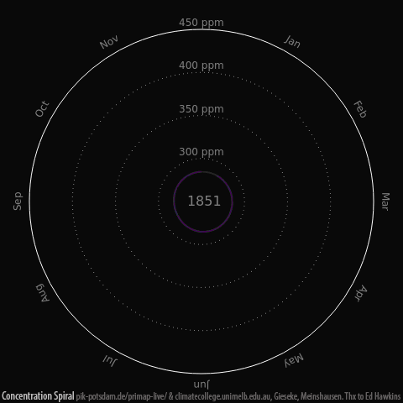

Slide 2
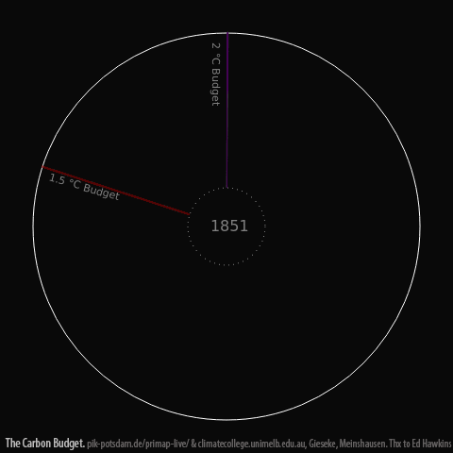

Slide 3
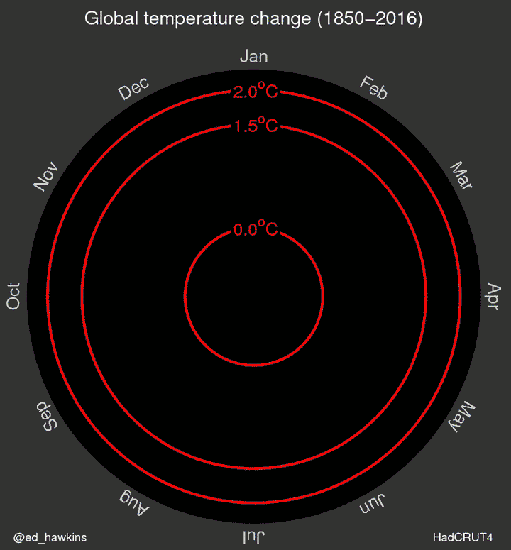

Slide 4
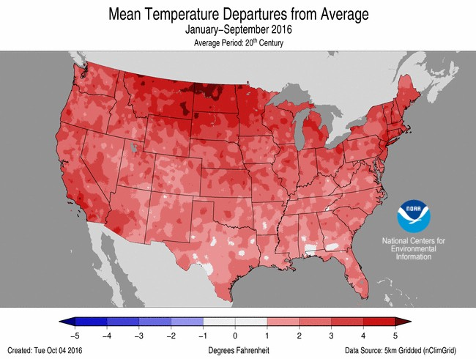

Slide 5
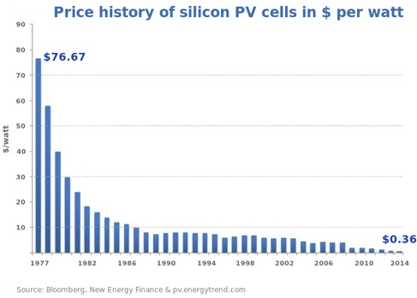

Slide 6
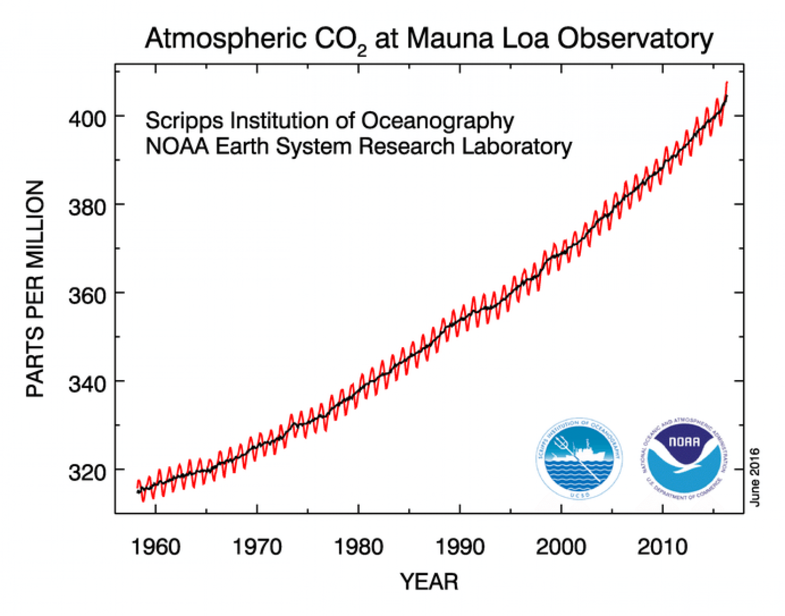
280 ppm 403.5

Slide 7
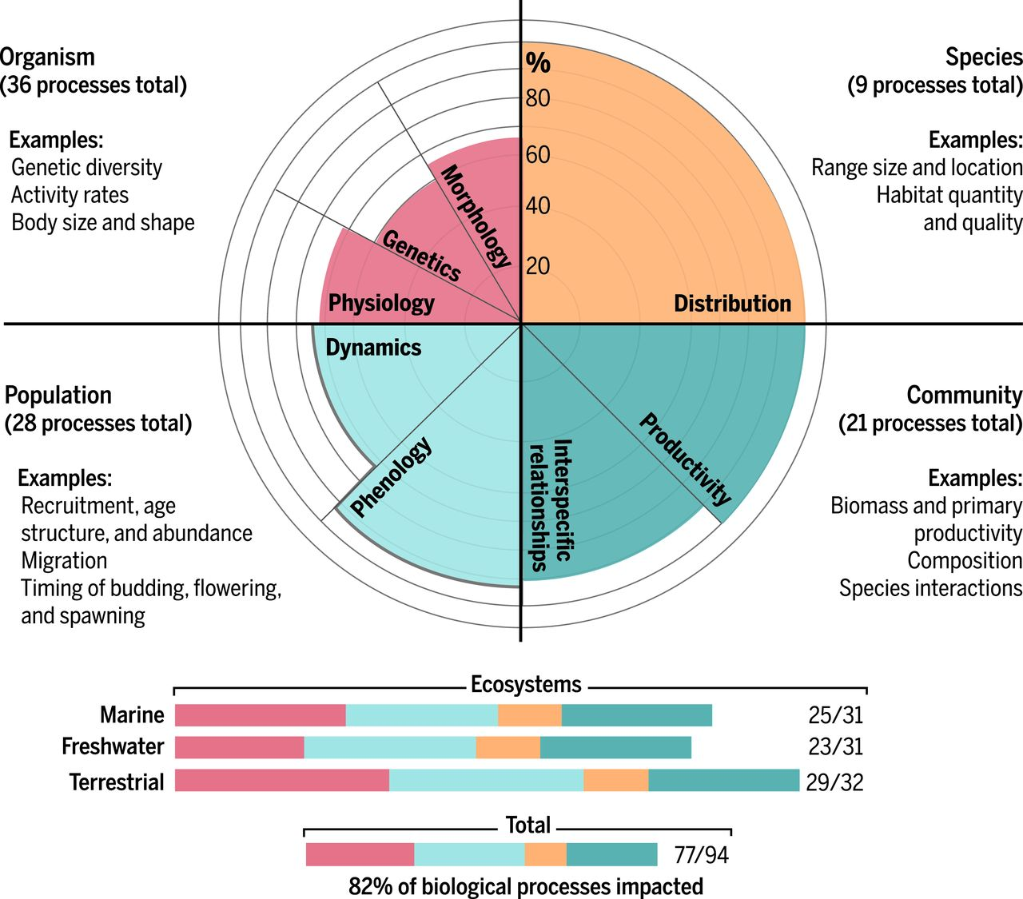

Slide 8
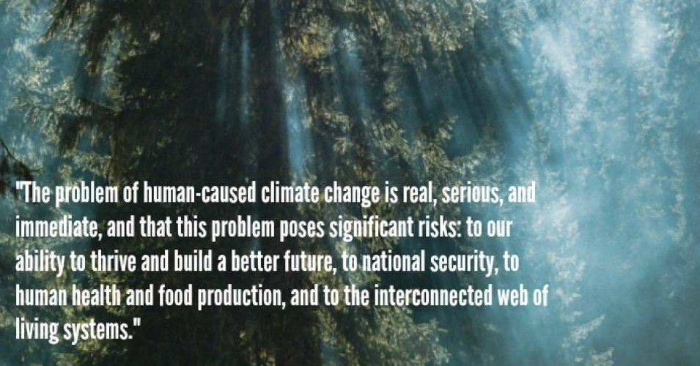
Letter signed by 375 members of the National Academy of Sciences
Including 30 Nobel Laureates, September 20, 1916

Slide 9
The climatic impacts of releasing fossil fuel CO₂ to the
atmosphere will last longer than Stonehenge. Longer than
time capsules, longer than nuclear waste, far longer than
the age of human civilization so far. Each ton of coal that
we burn leaves CO₂ gas in the atmosphere. The CO₂ coming
from a quarter of that ton will still be affecting the climate one
thousand years from now.
David Archer, 2009

Slide 10
goals . . .
13 acre development—Green Arts District
USGBC Platinum^{nd} & economic revitalization
Climate neutral—City and College
Clinton Climate Initiative
White House ‘Climate Champion City’
greenbelt: local foods 70%
education—1000 students/10 years
College, LCCC, LCVS, & public schools
replicate: Lake Erie Crescent Project, others . . .

Slide 11
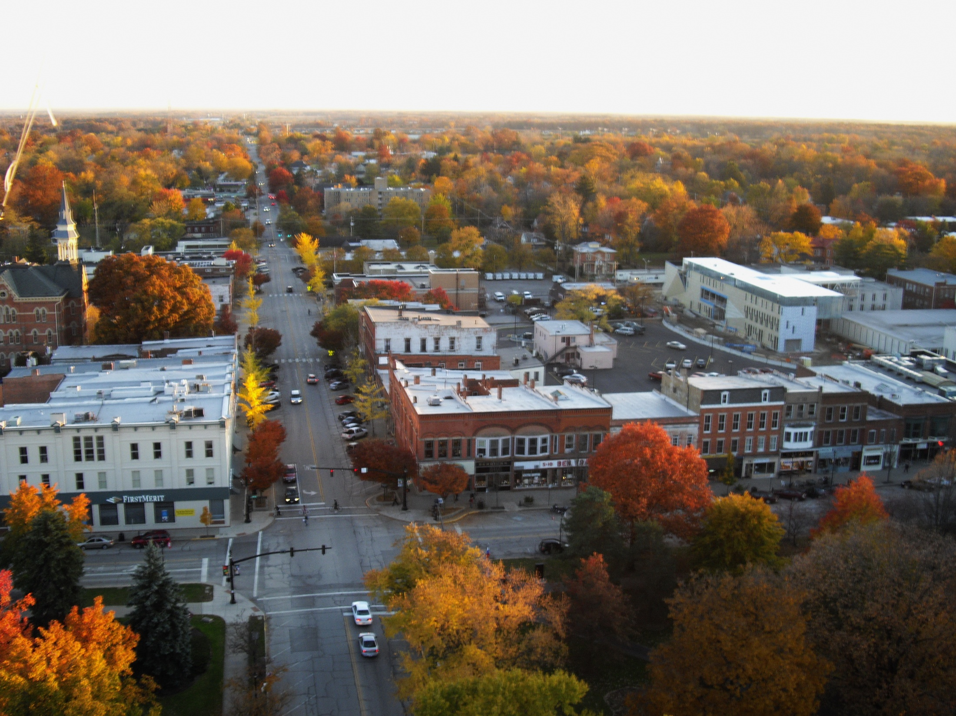
The Oberlin Project 2009
Founded 1832
City of ~10,000
28% below poverty
52% free/reduced lunch
Photo courtesy of John Petersen

Slide 12
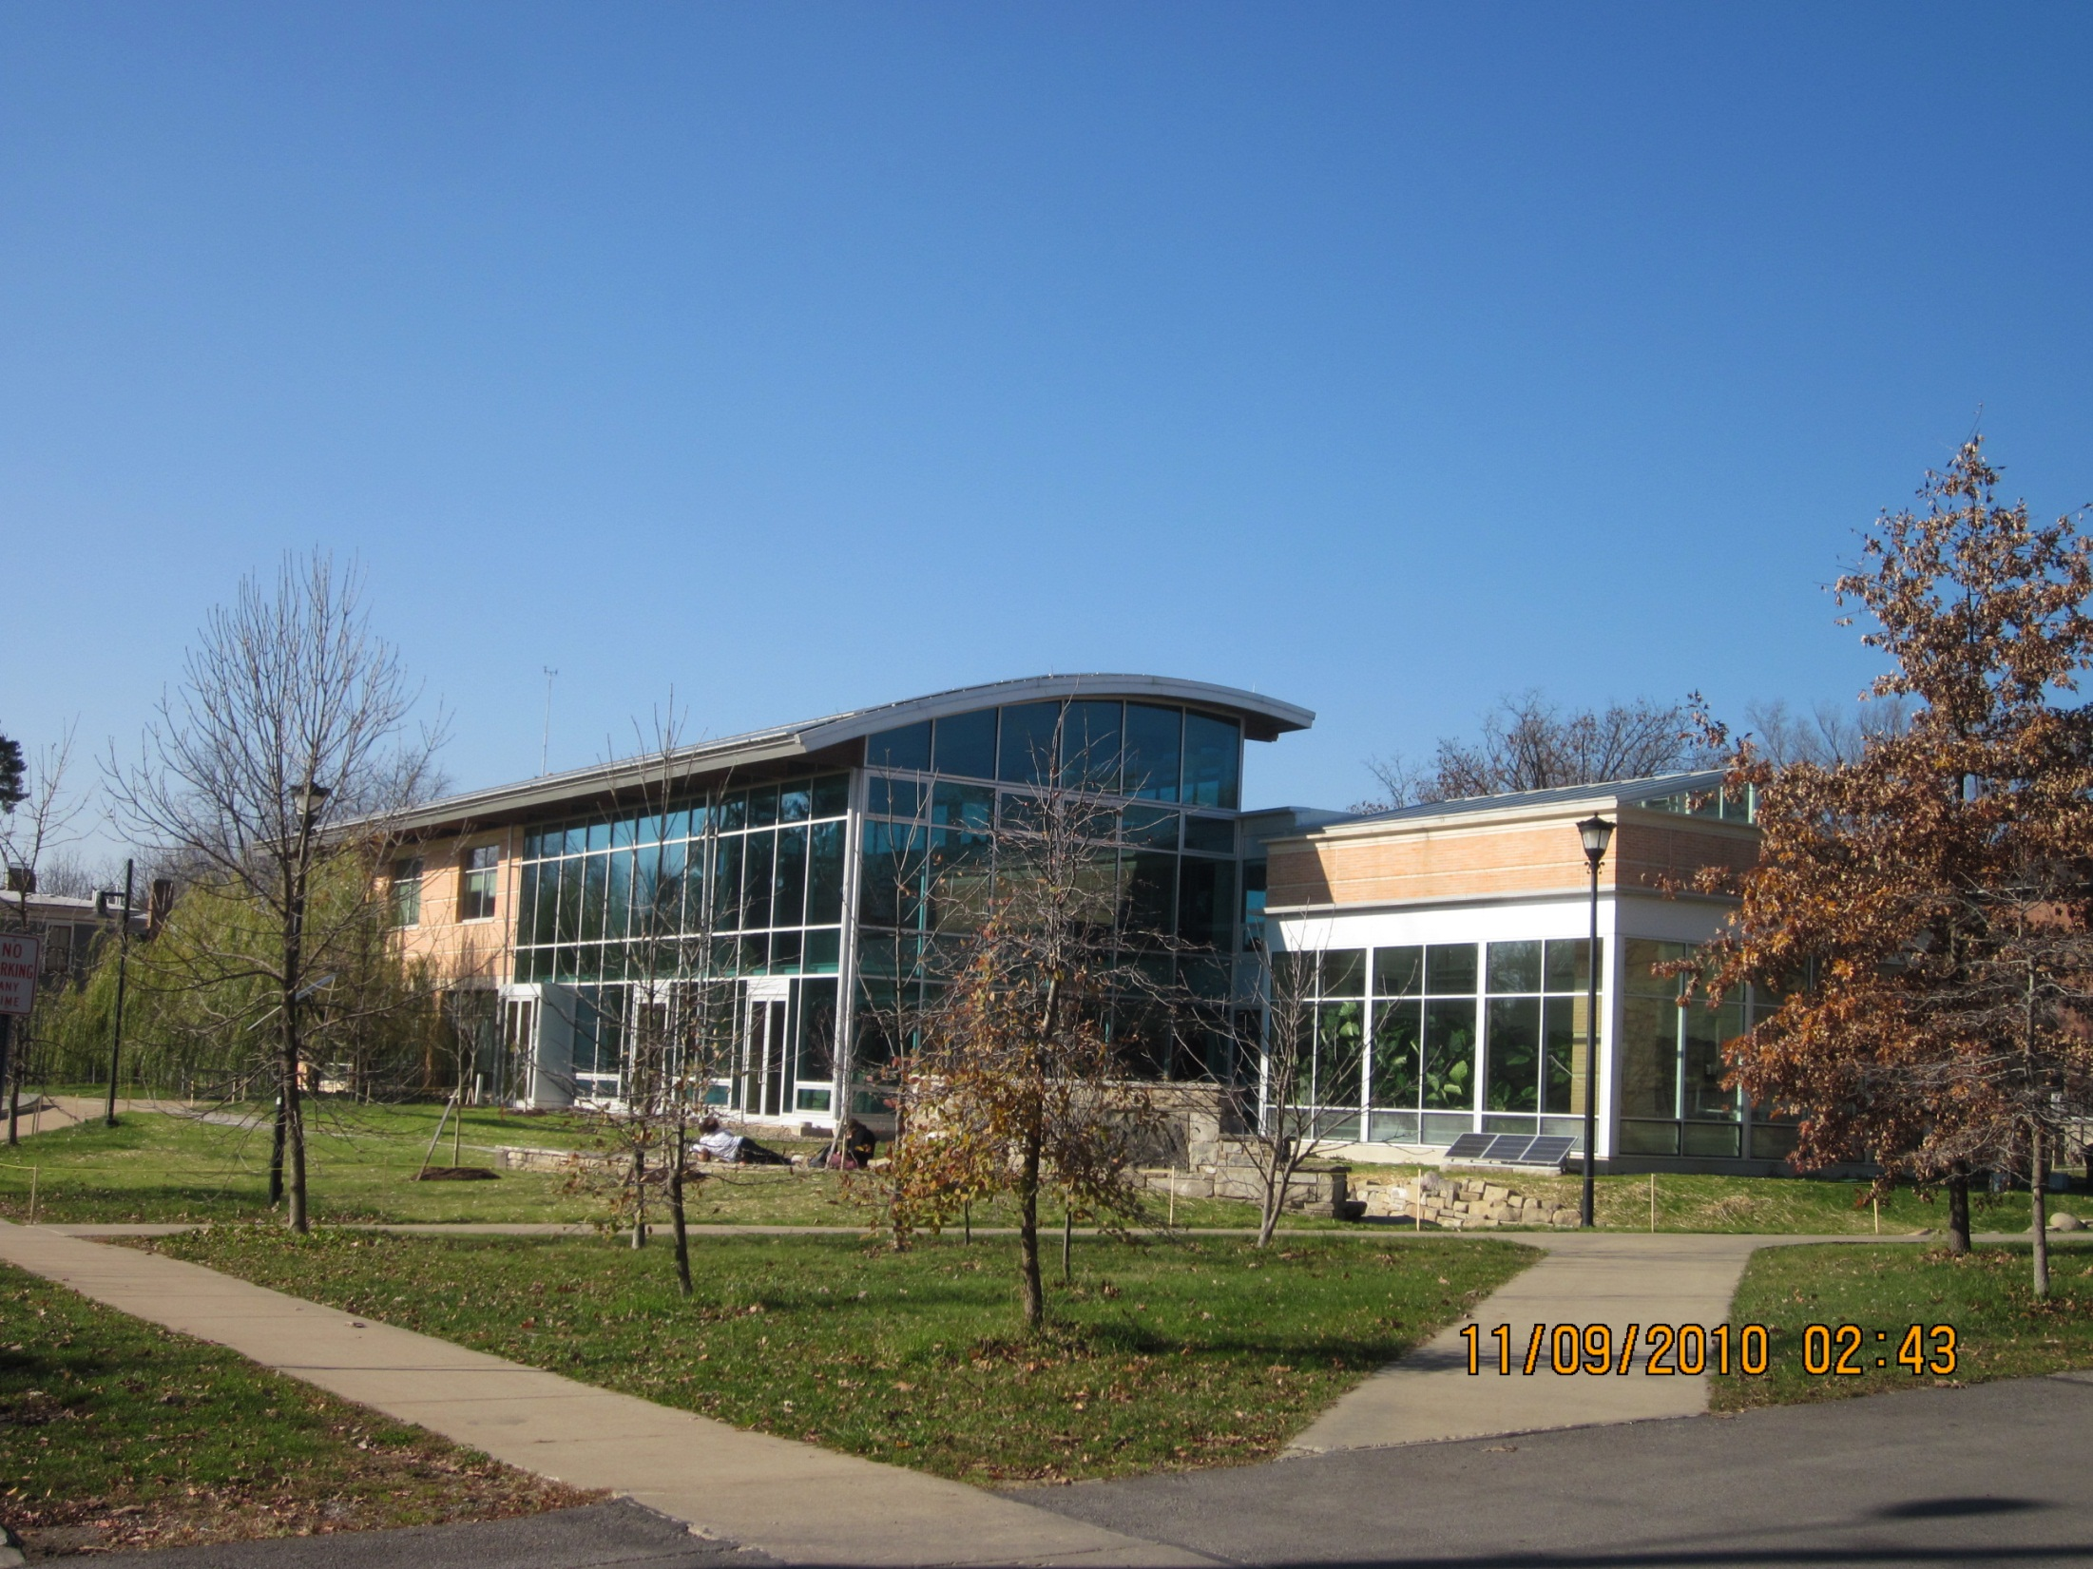
Adam Joseph Lewis Center
“one of thirty milestone buildings in 20th century,” DOE
“most important green building in past 30 years,” AIA
“One of 30 ‘game changers’ of past 170 years”
Building Design + Construction (January, 2016)

Slide 13
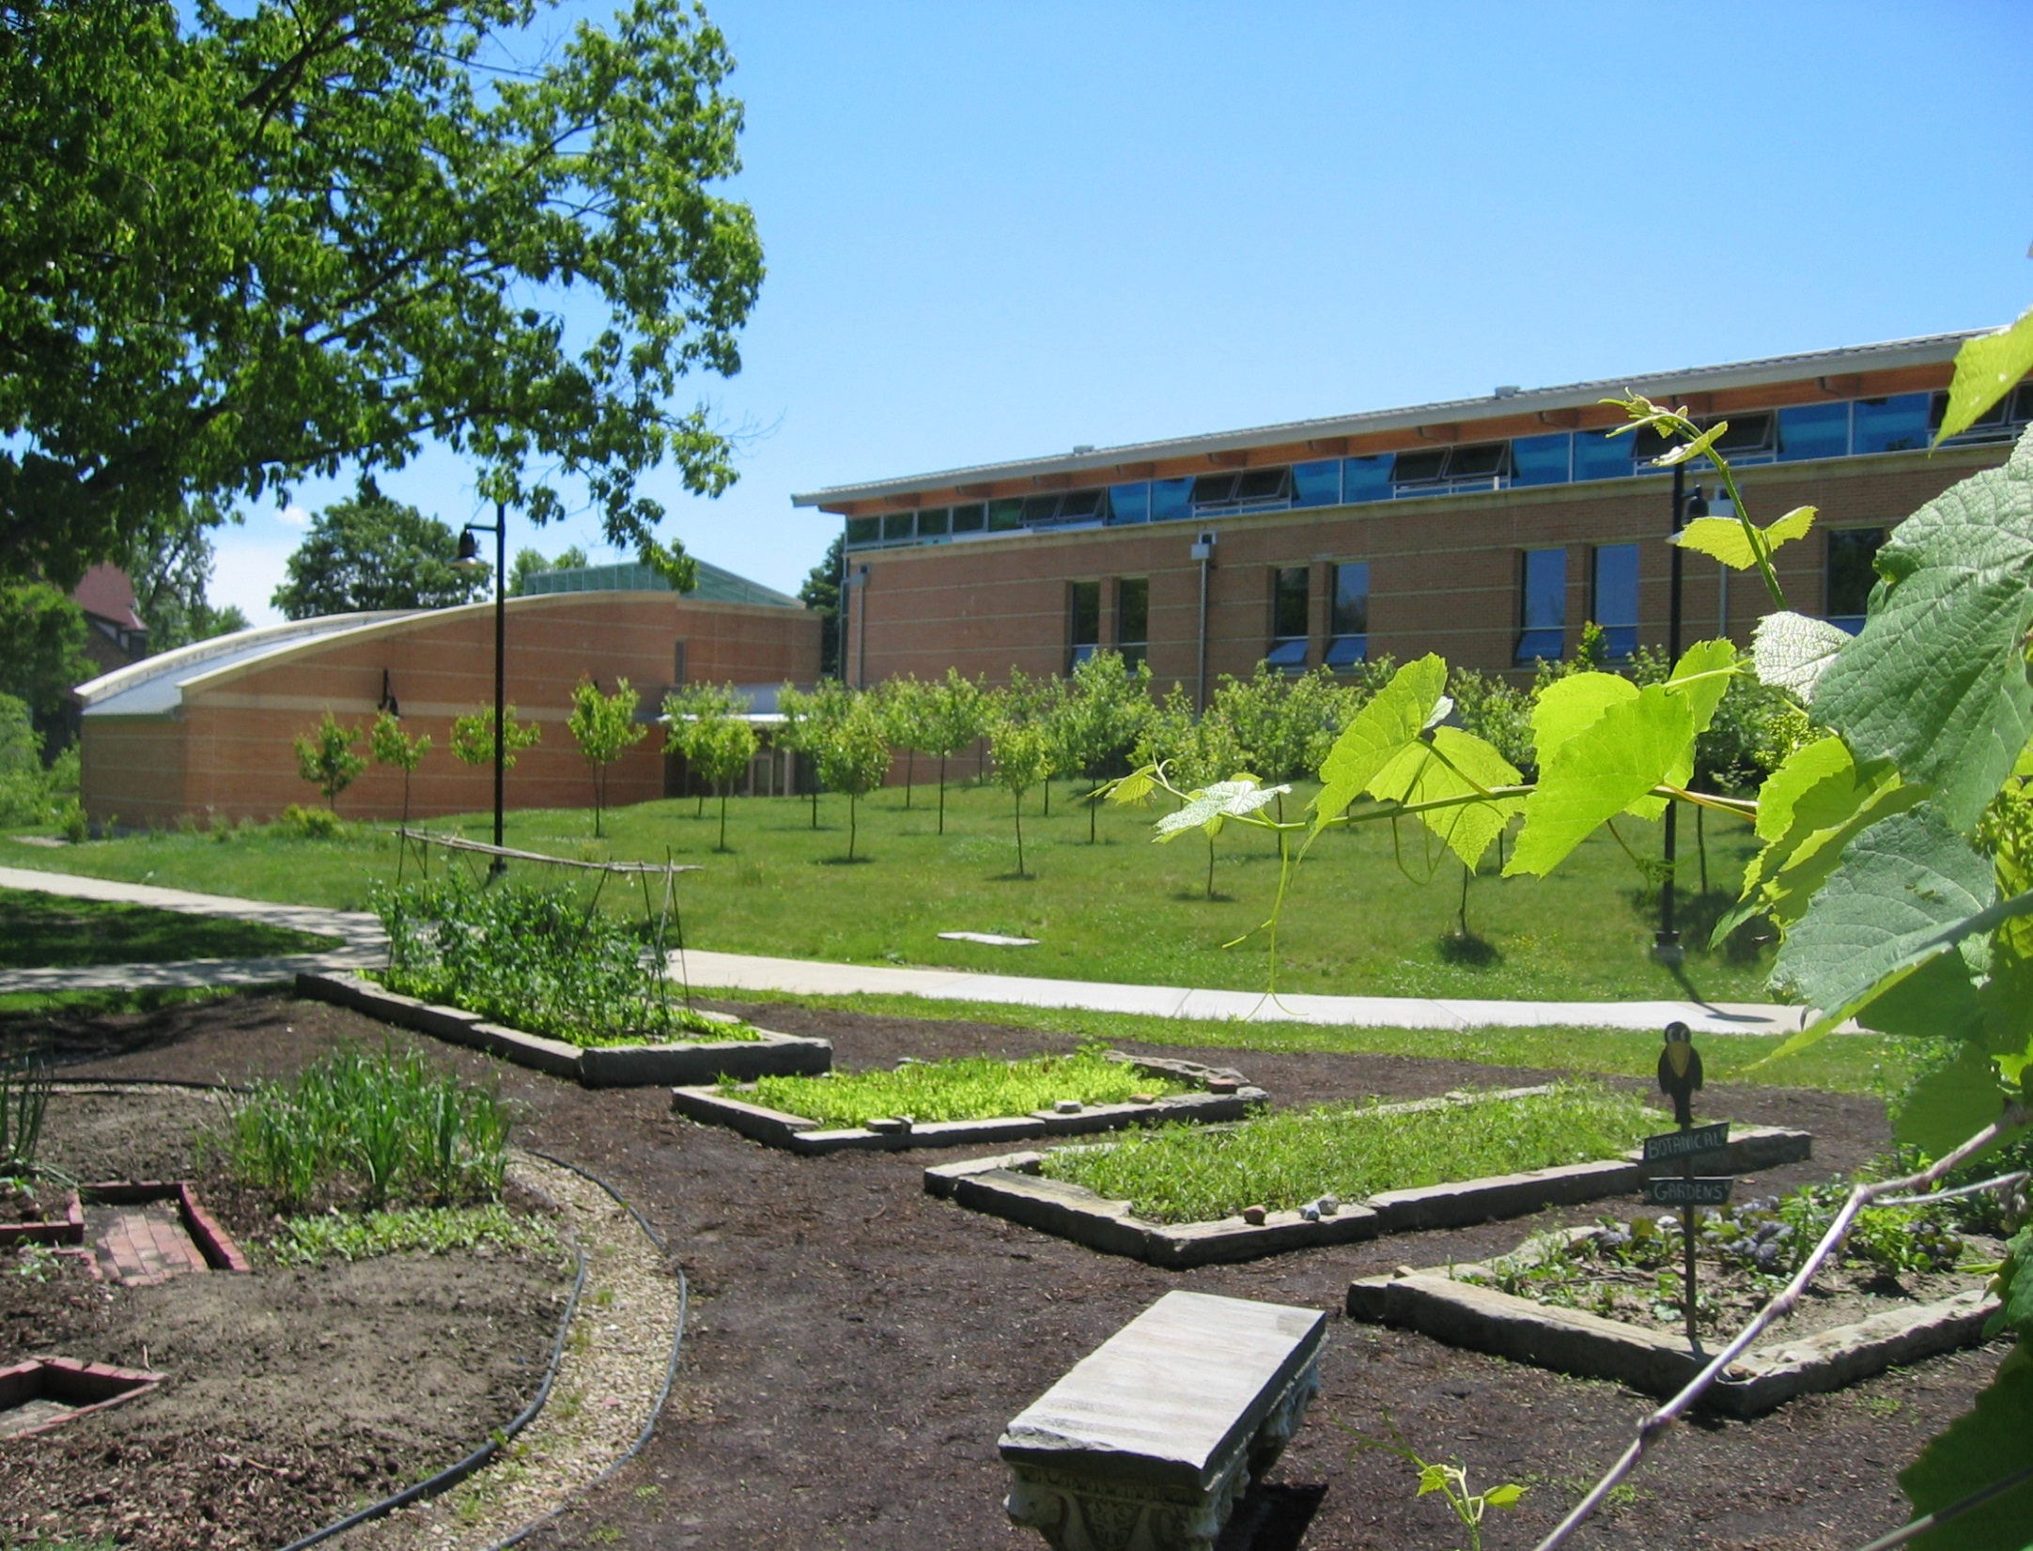

Slide 14
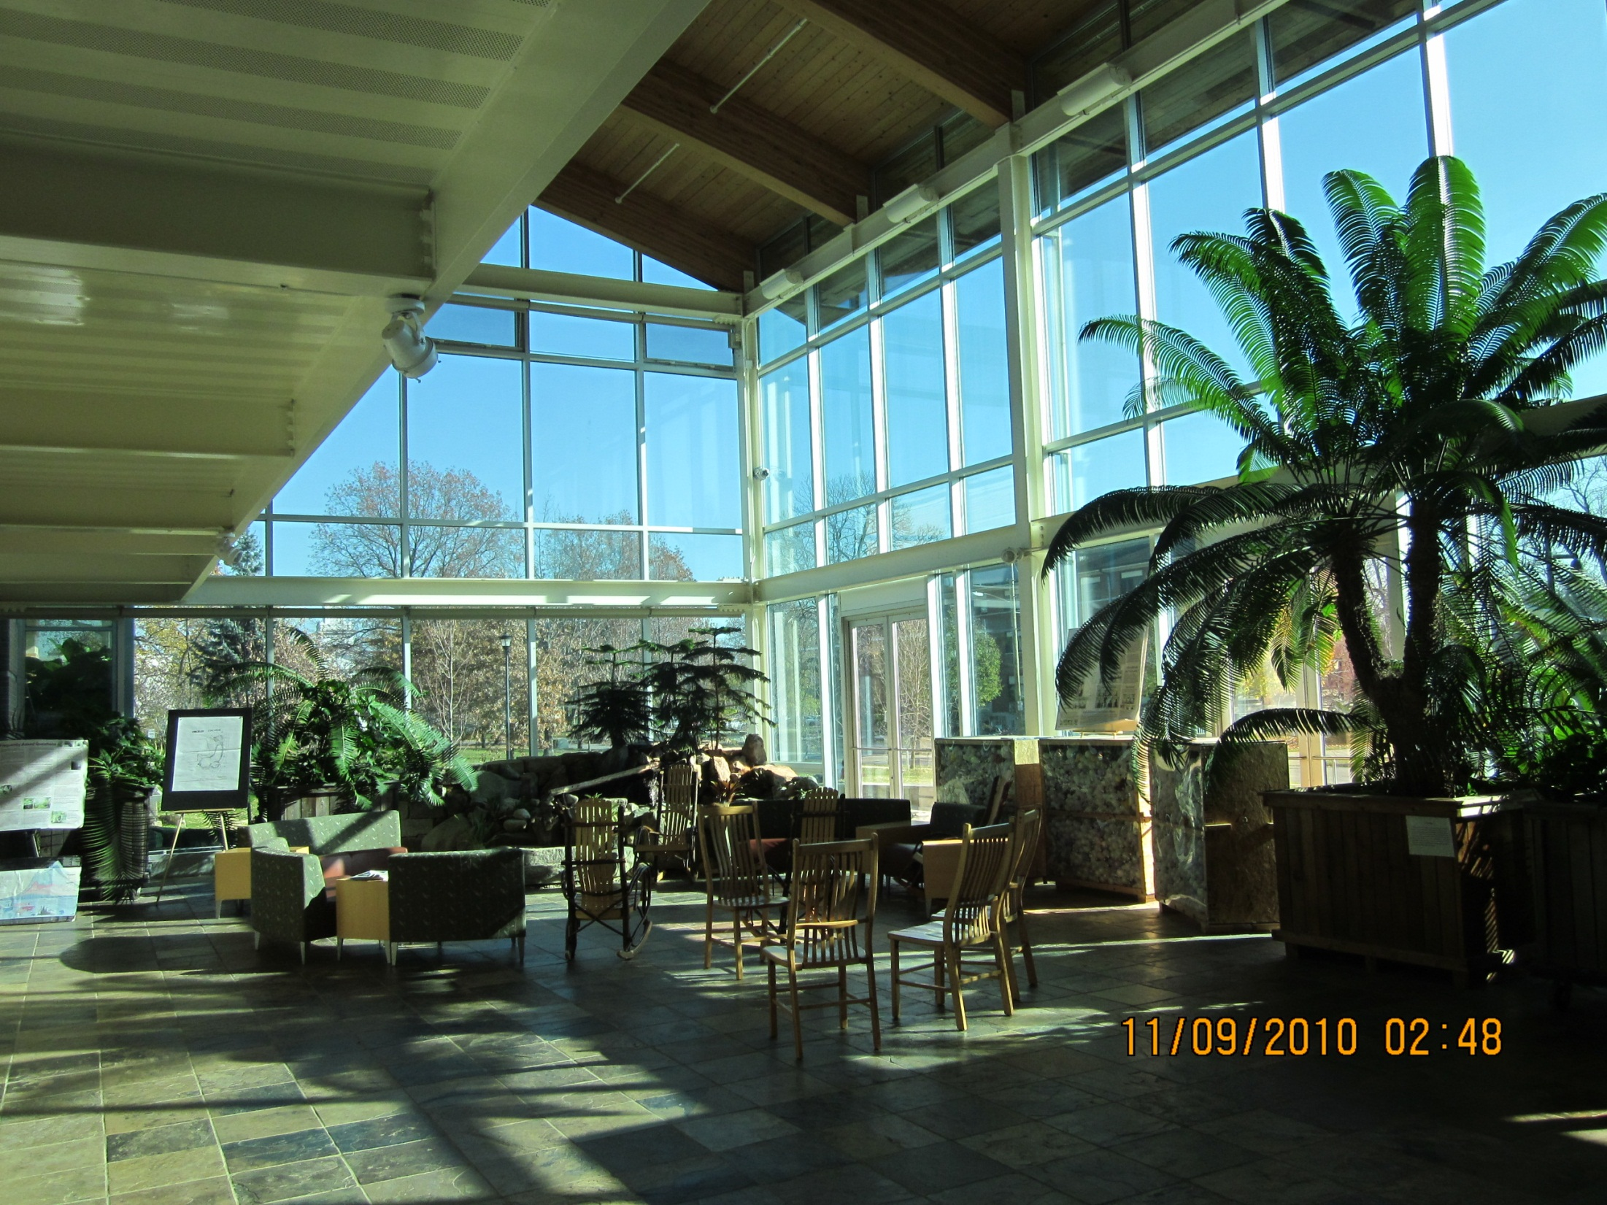

Slide 15
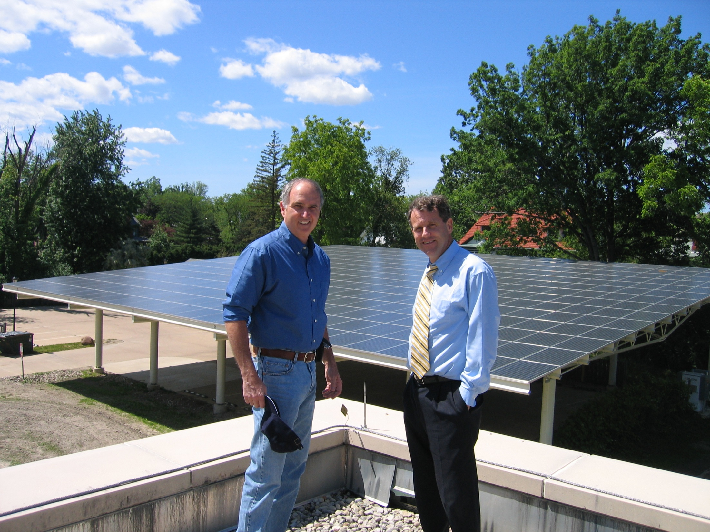

Slide 16
full spectrum sustainability:
parts reinforce the resilience of the whole
Leadership and coordination
Renewable energy &
Efficiency
Economic revitalization
Community mobilization
Agriculture & forestry
Policy & Law
Education
communication

Slide 17
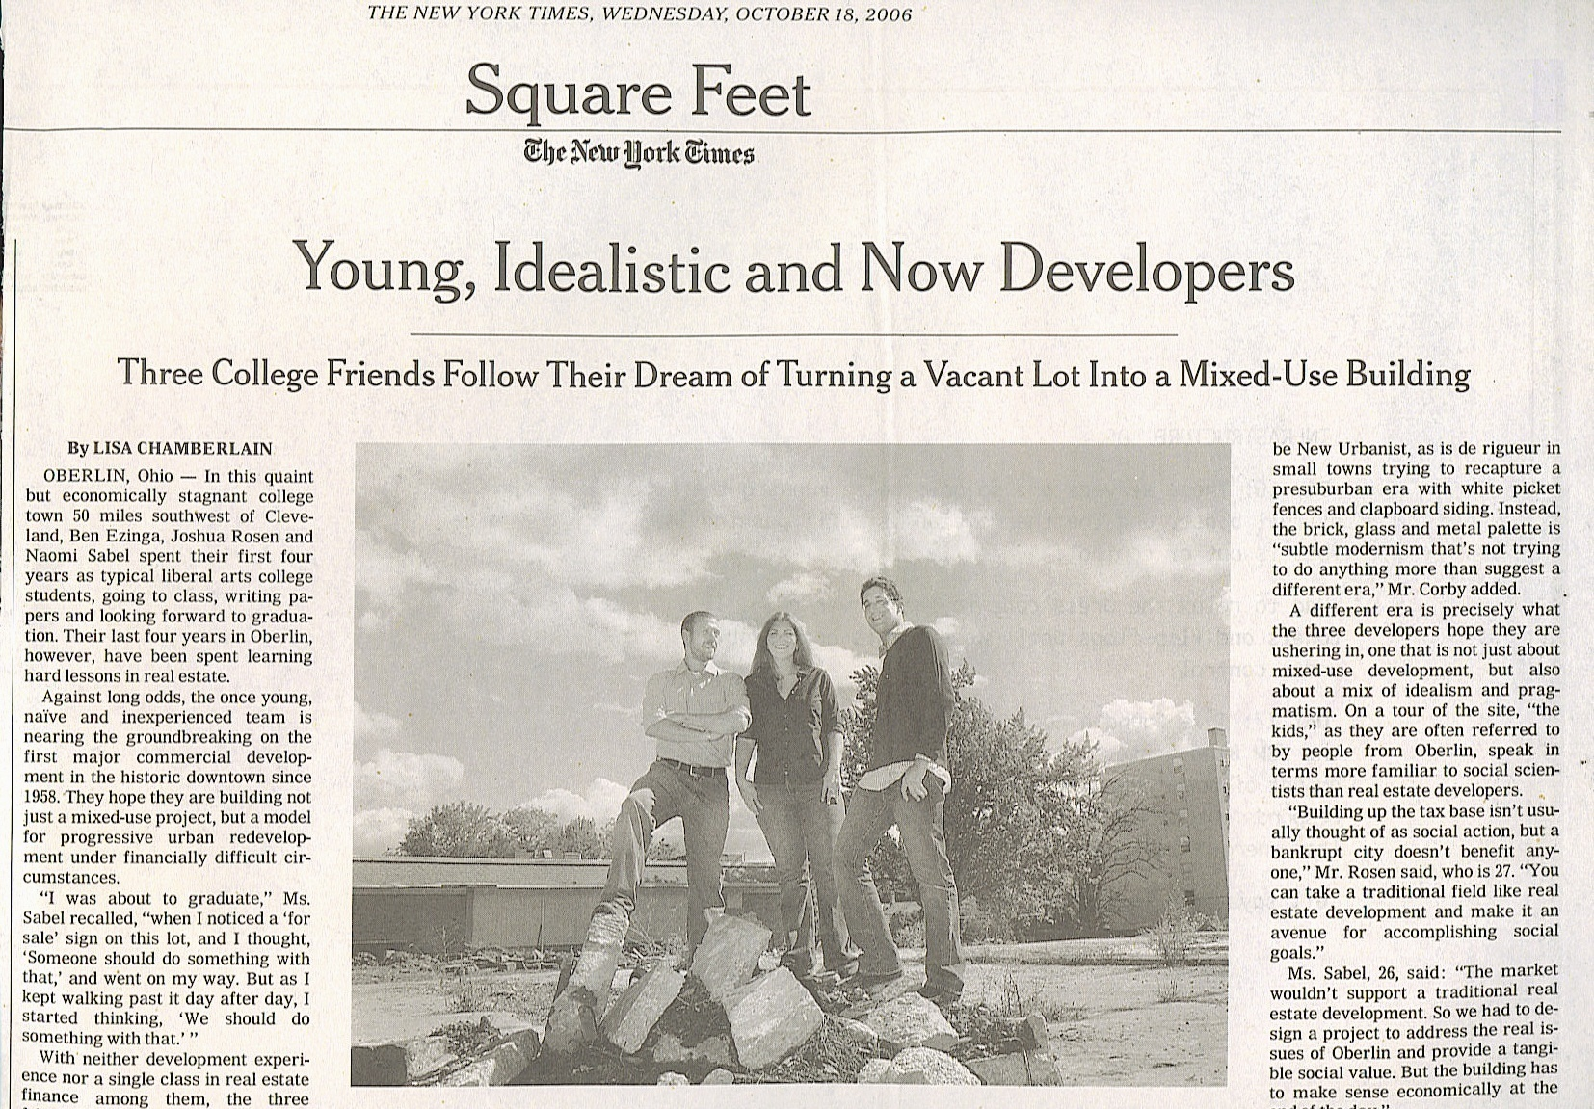
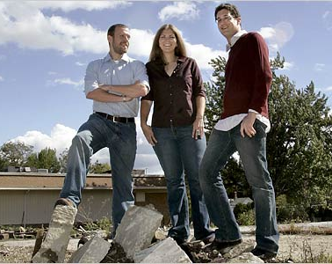

Slide 18
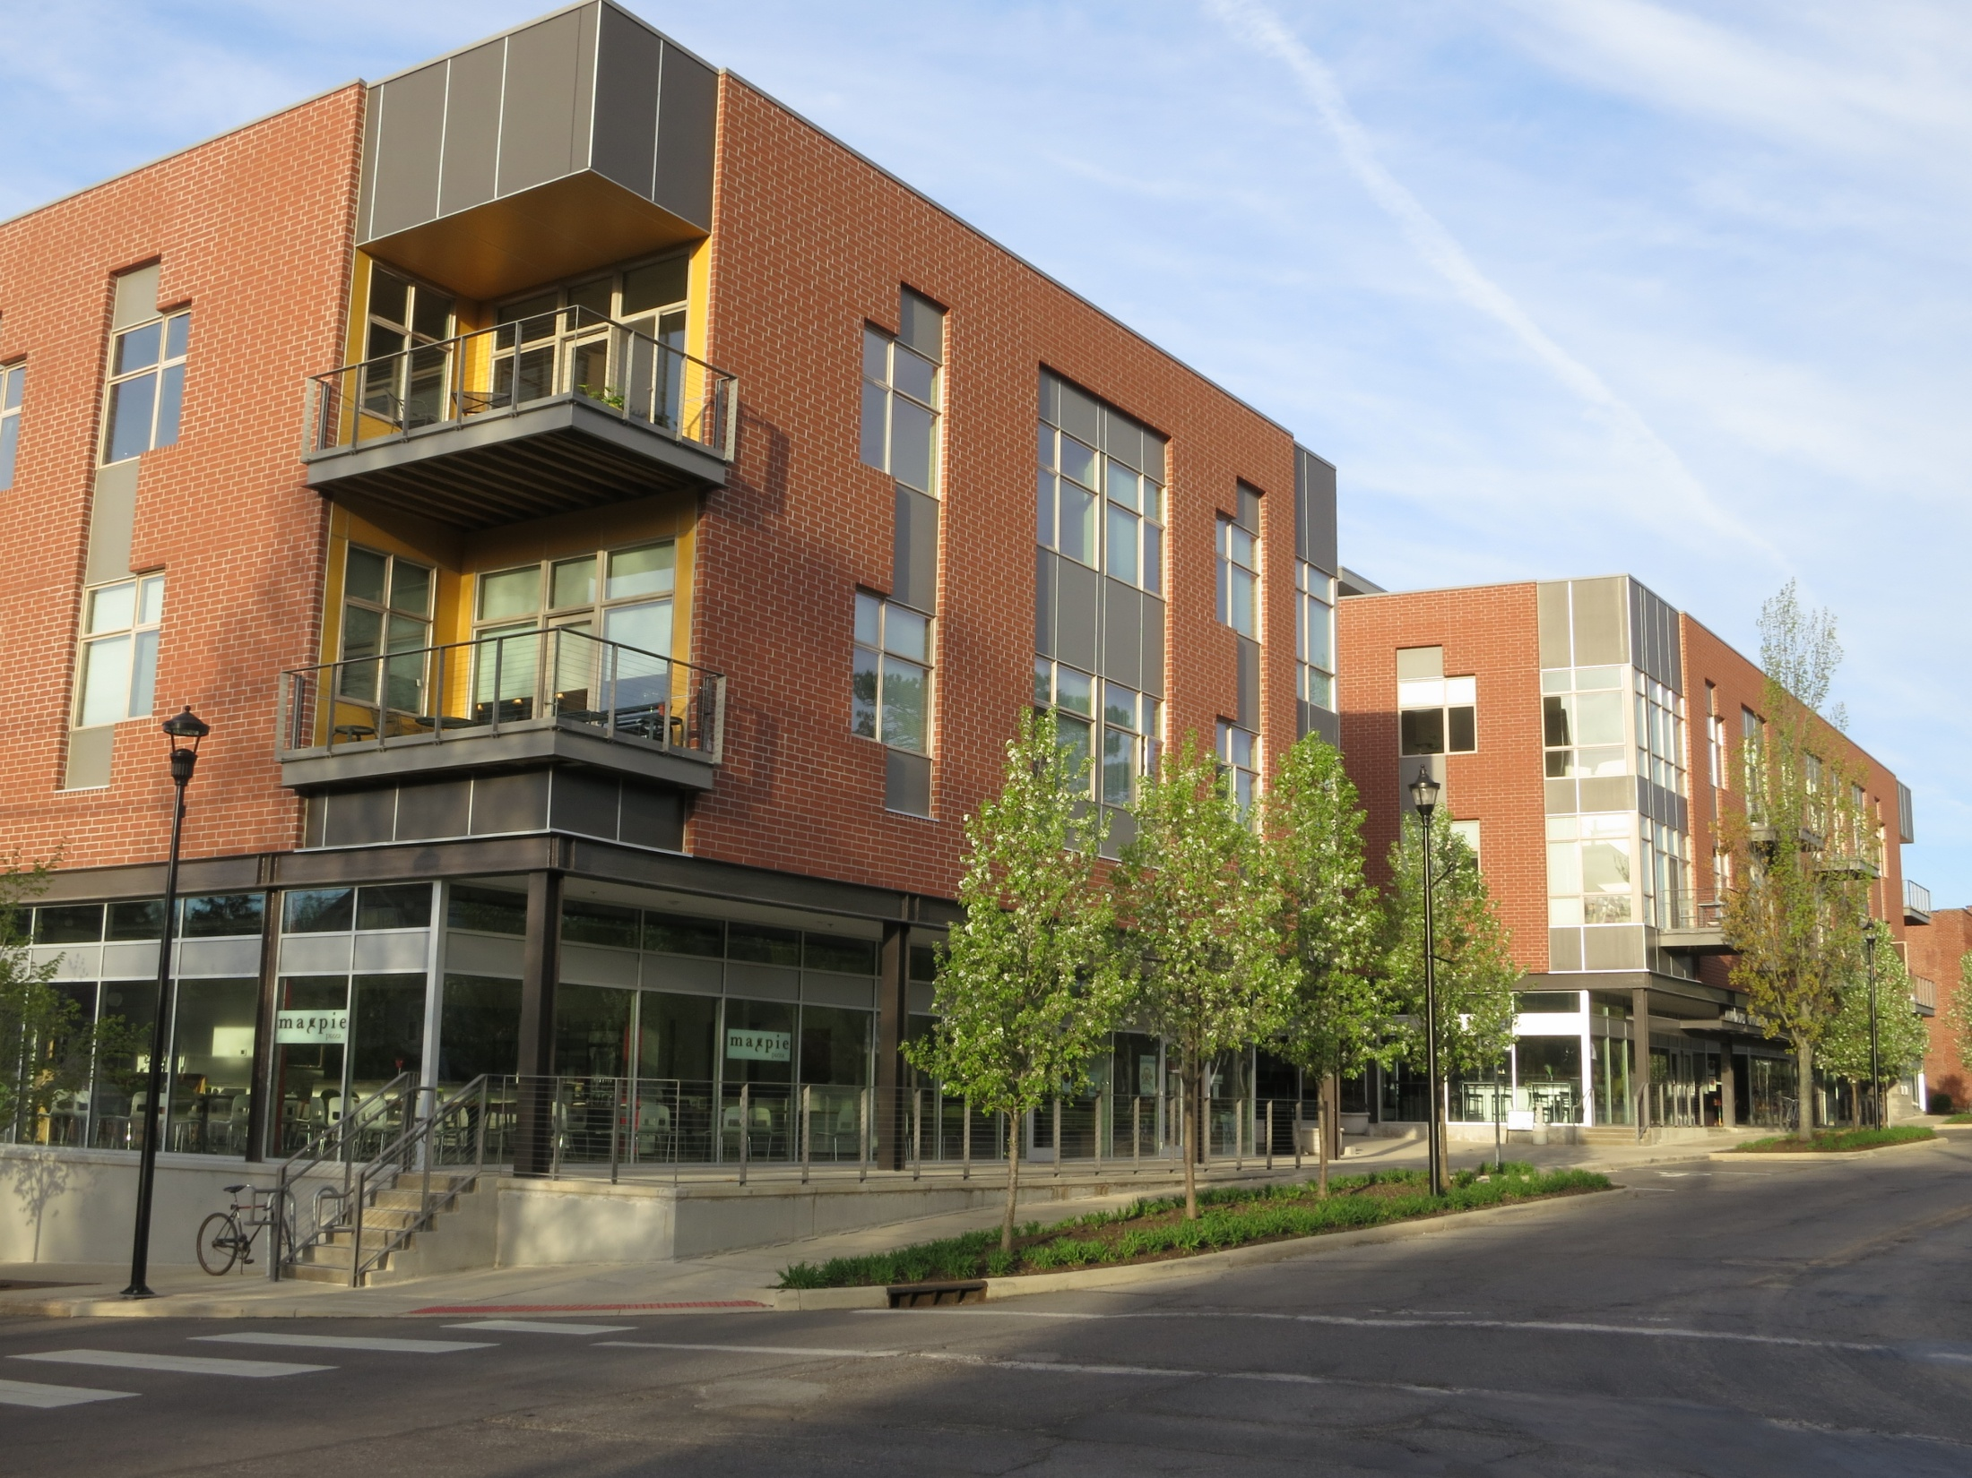

Slide 19
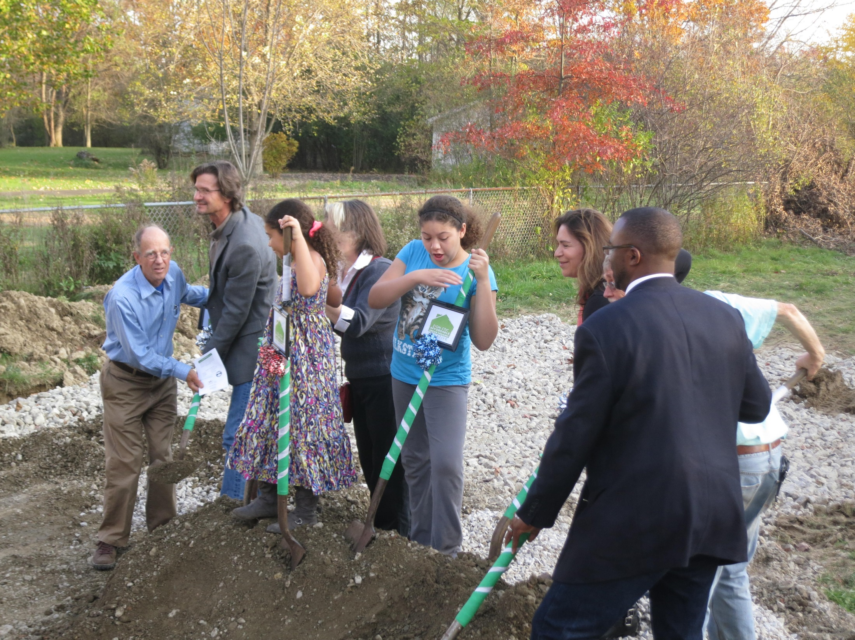

Slide 20
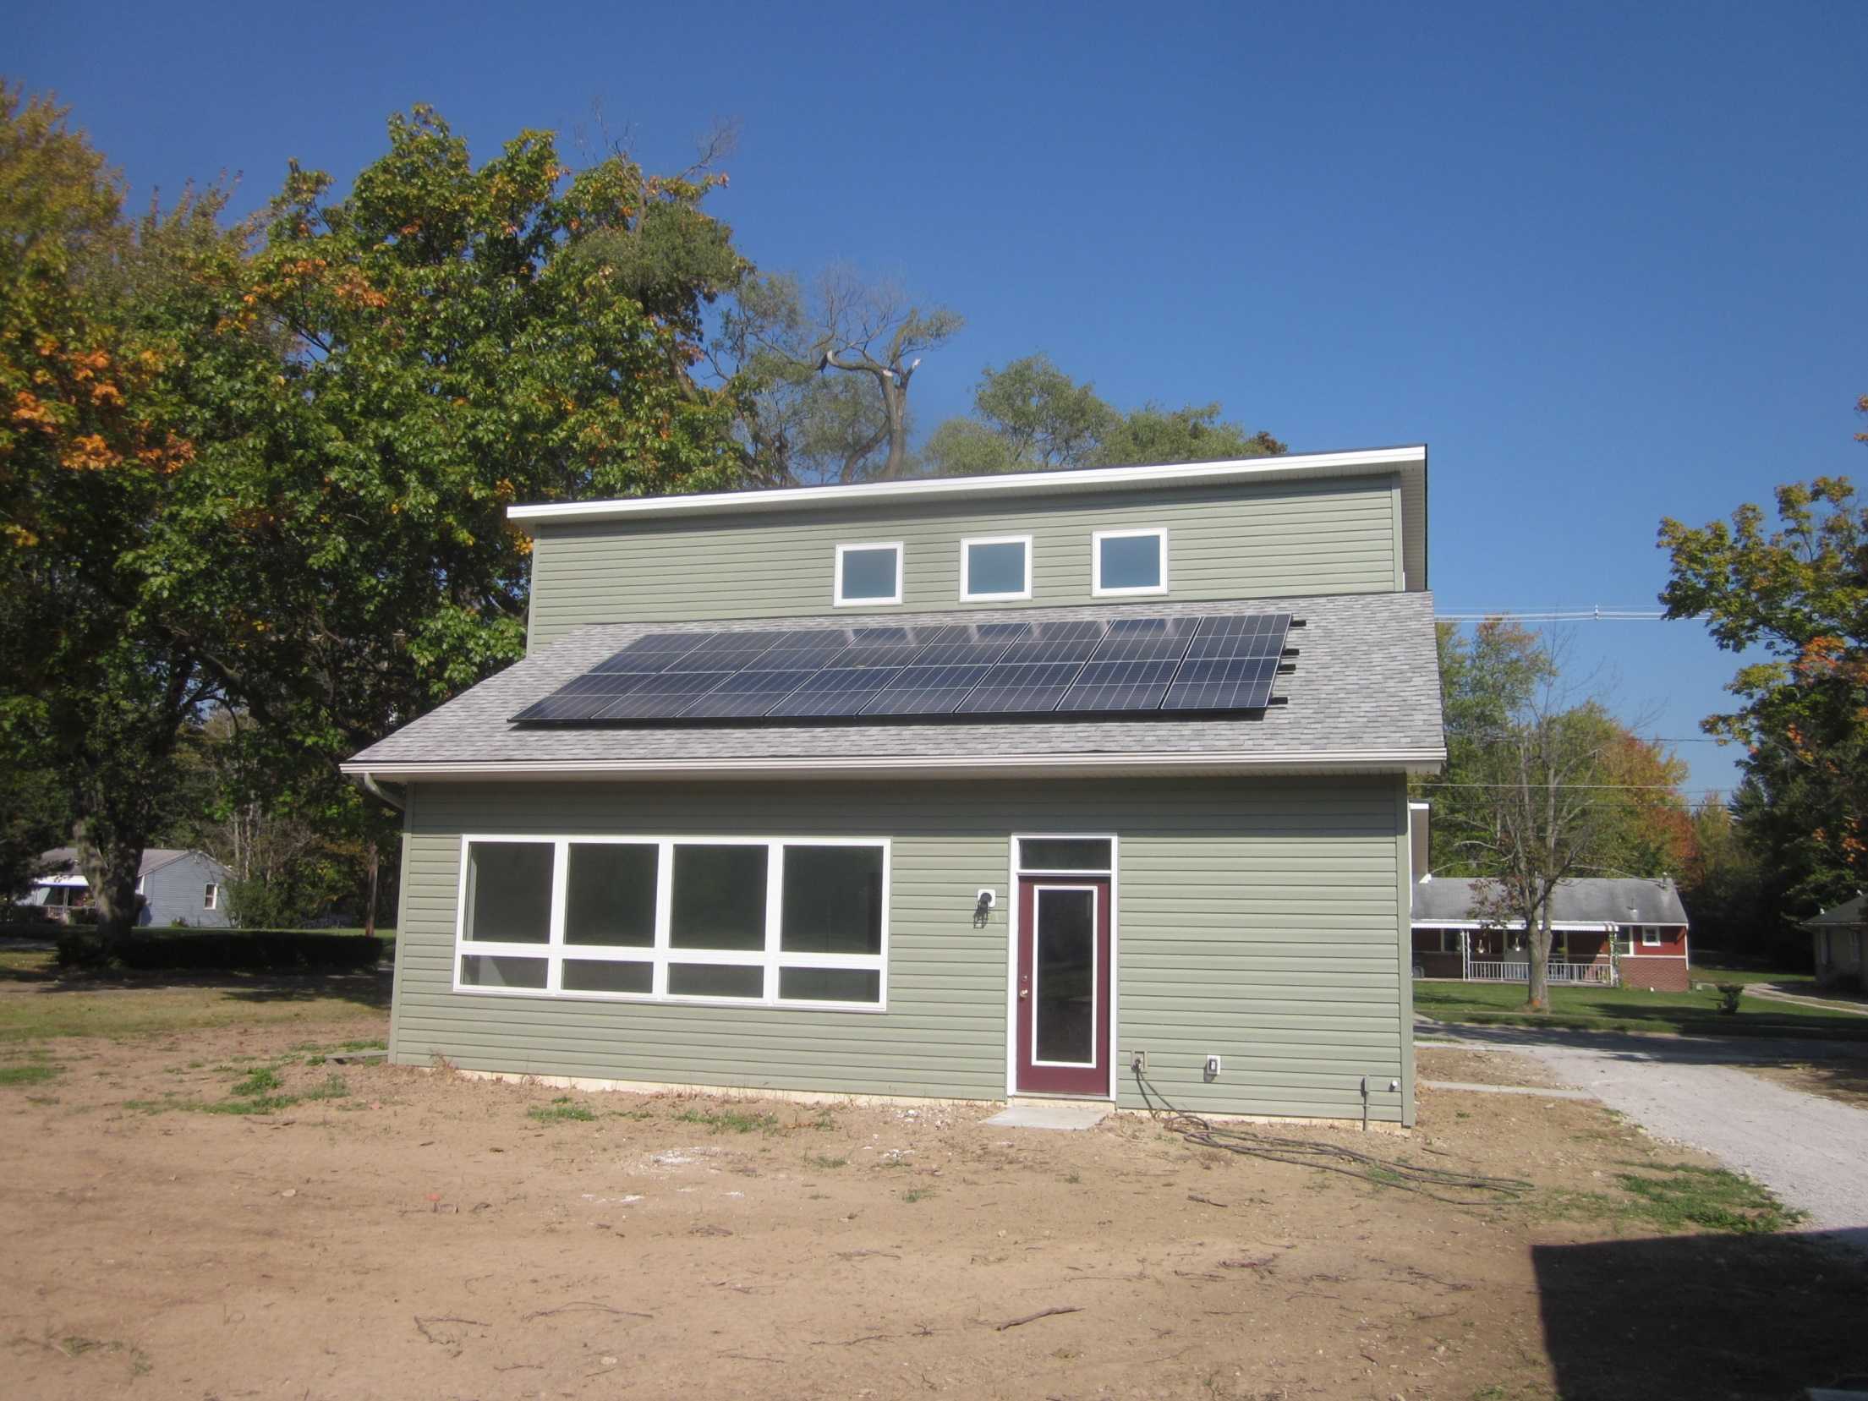

Slide 21
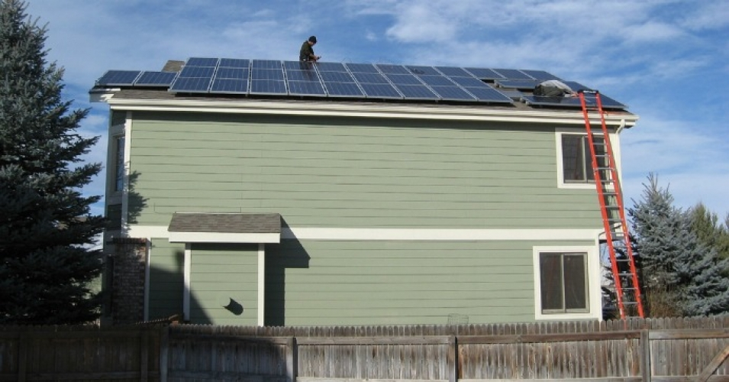

Slide 22
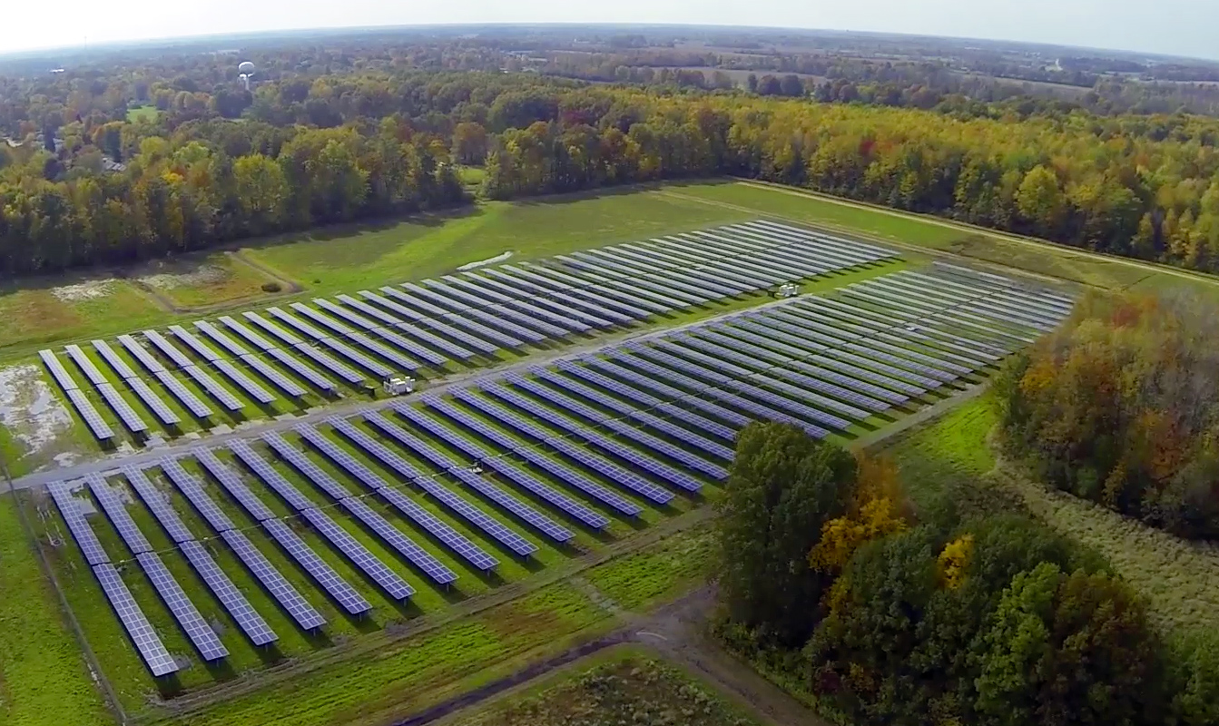
2.27MW . . . 3.2 MW output . . . baseload 11MW
White House: One of 16 “climate champion” cities
Clinton Climate Initiative “participant status,” C-40

Slide 23
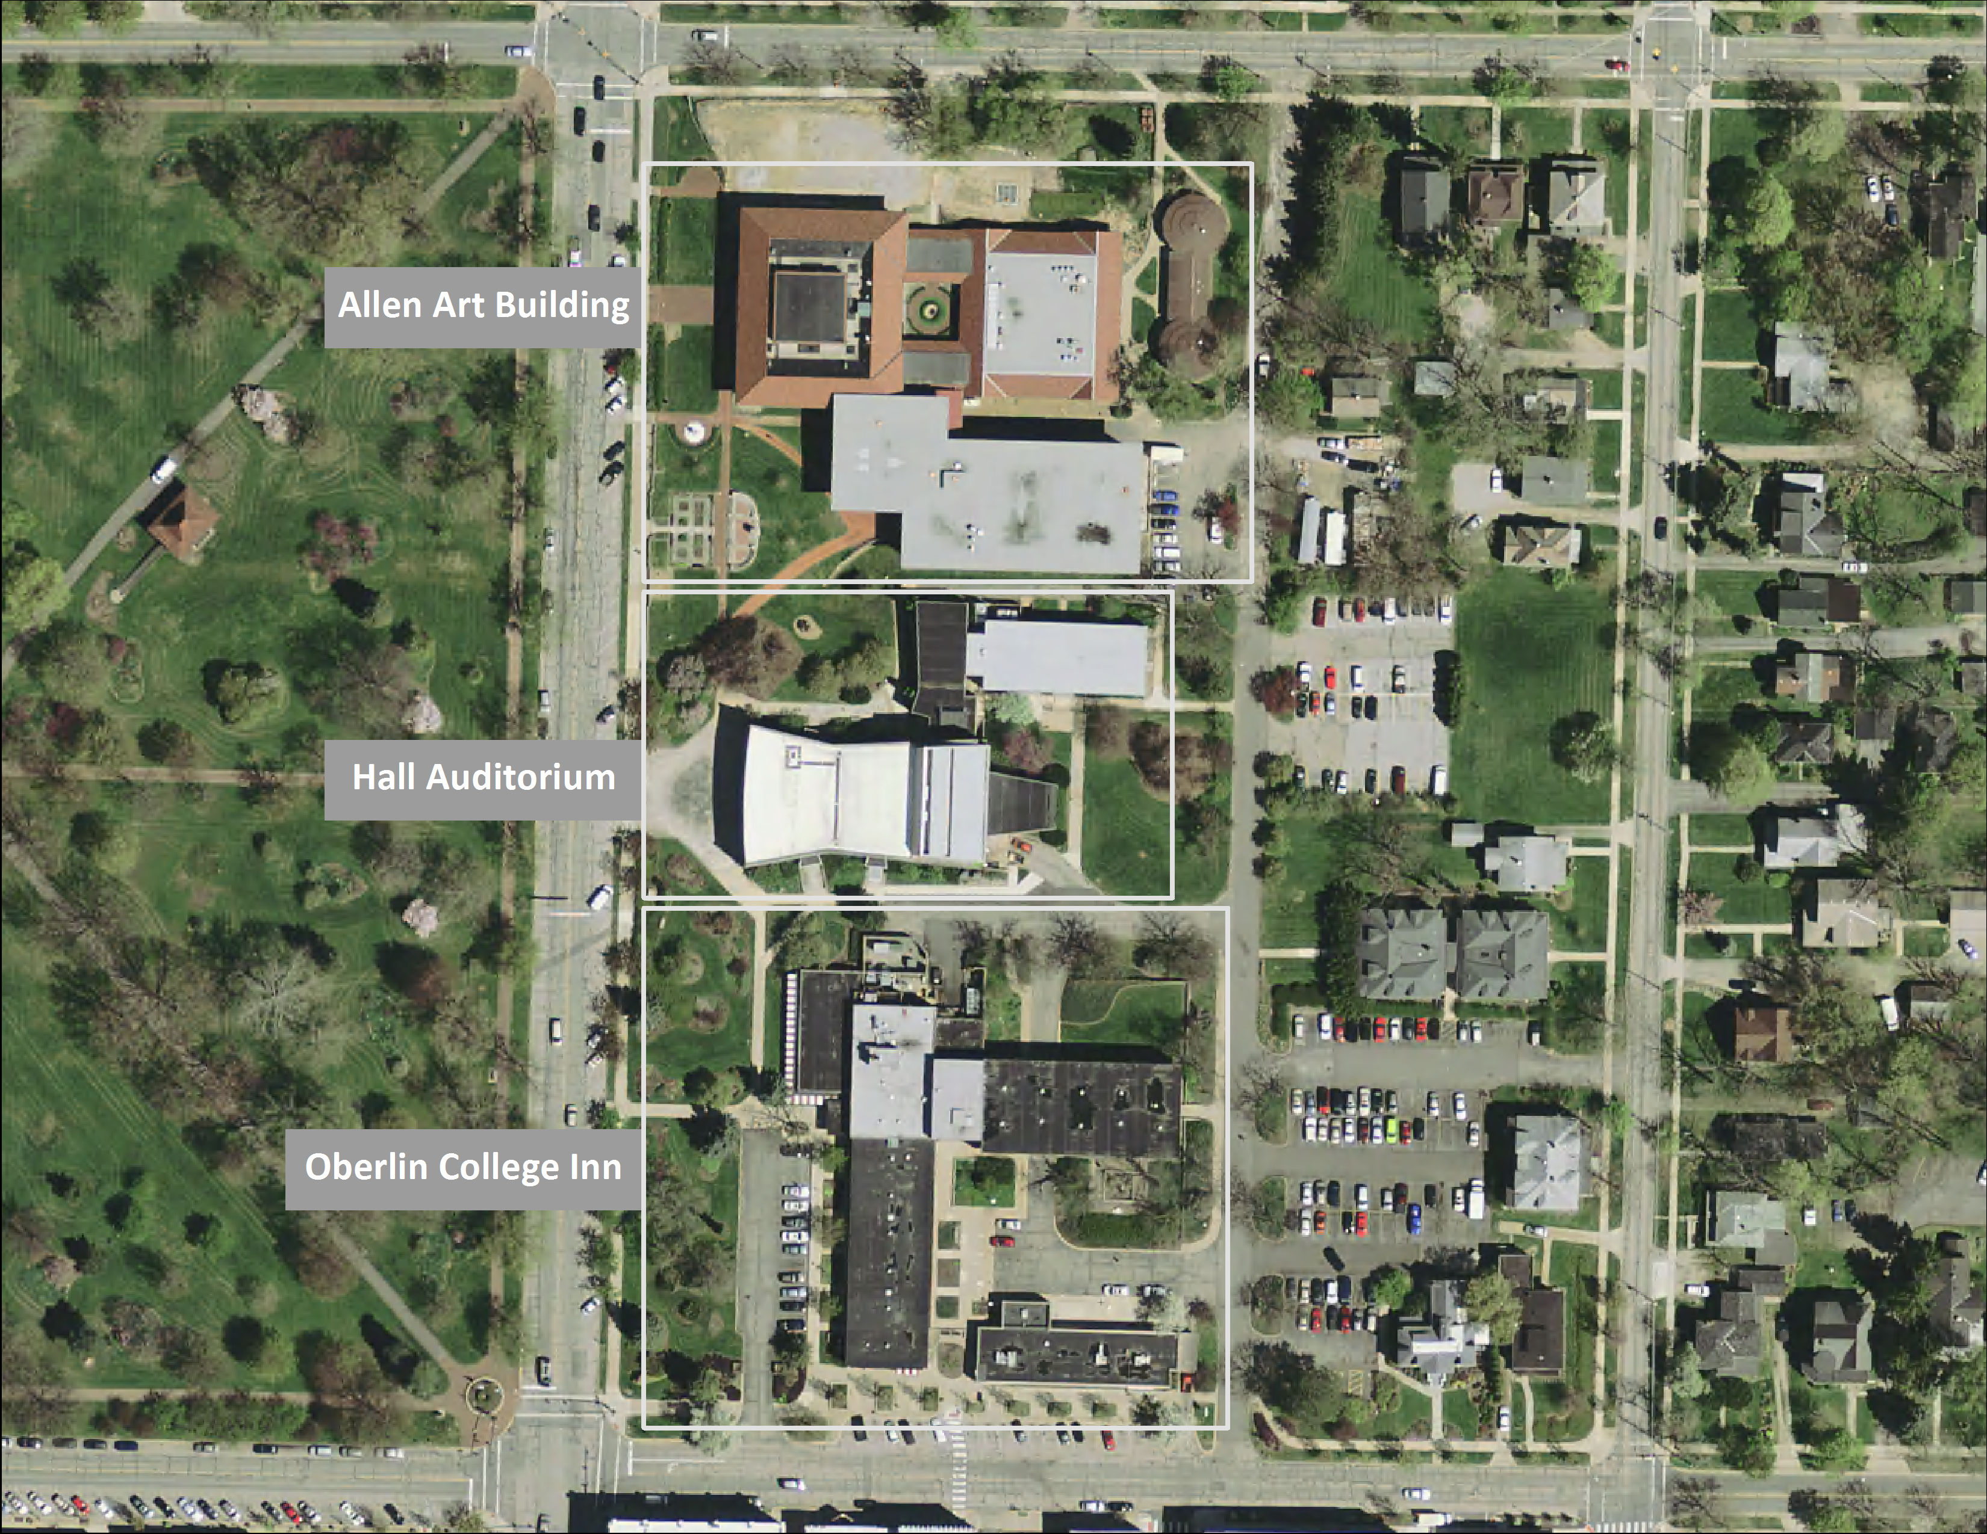

Slide 24
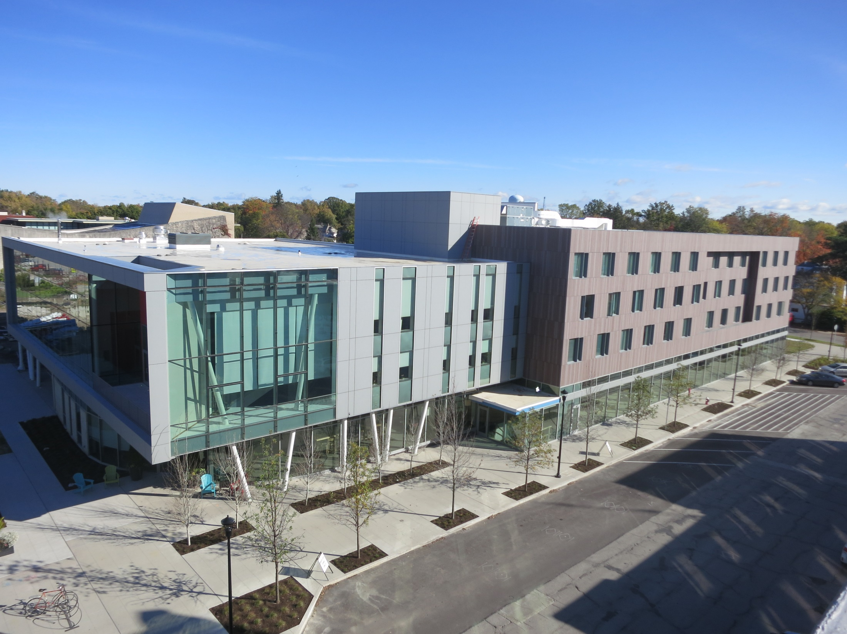

Slide 25
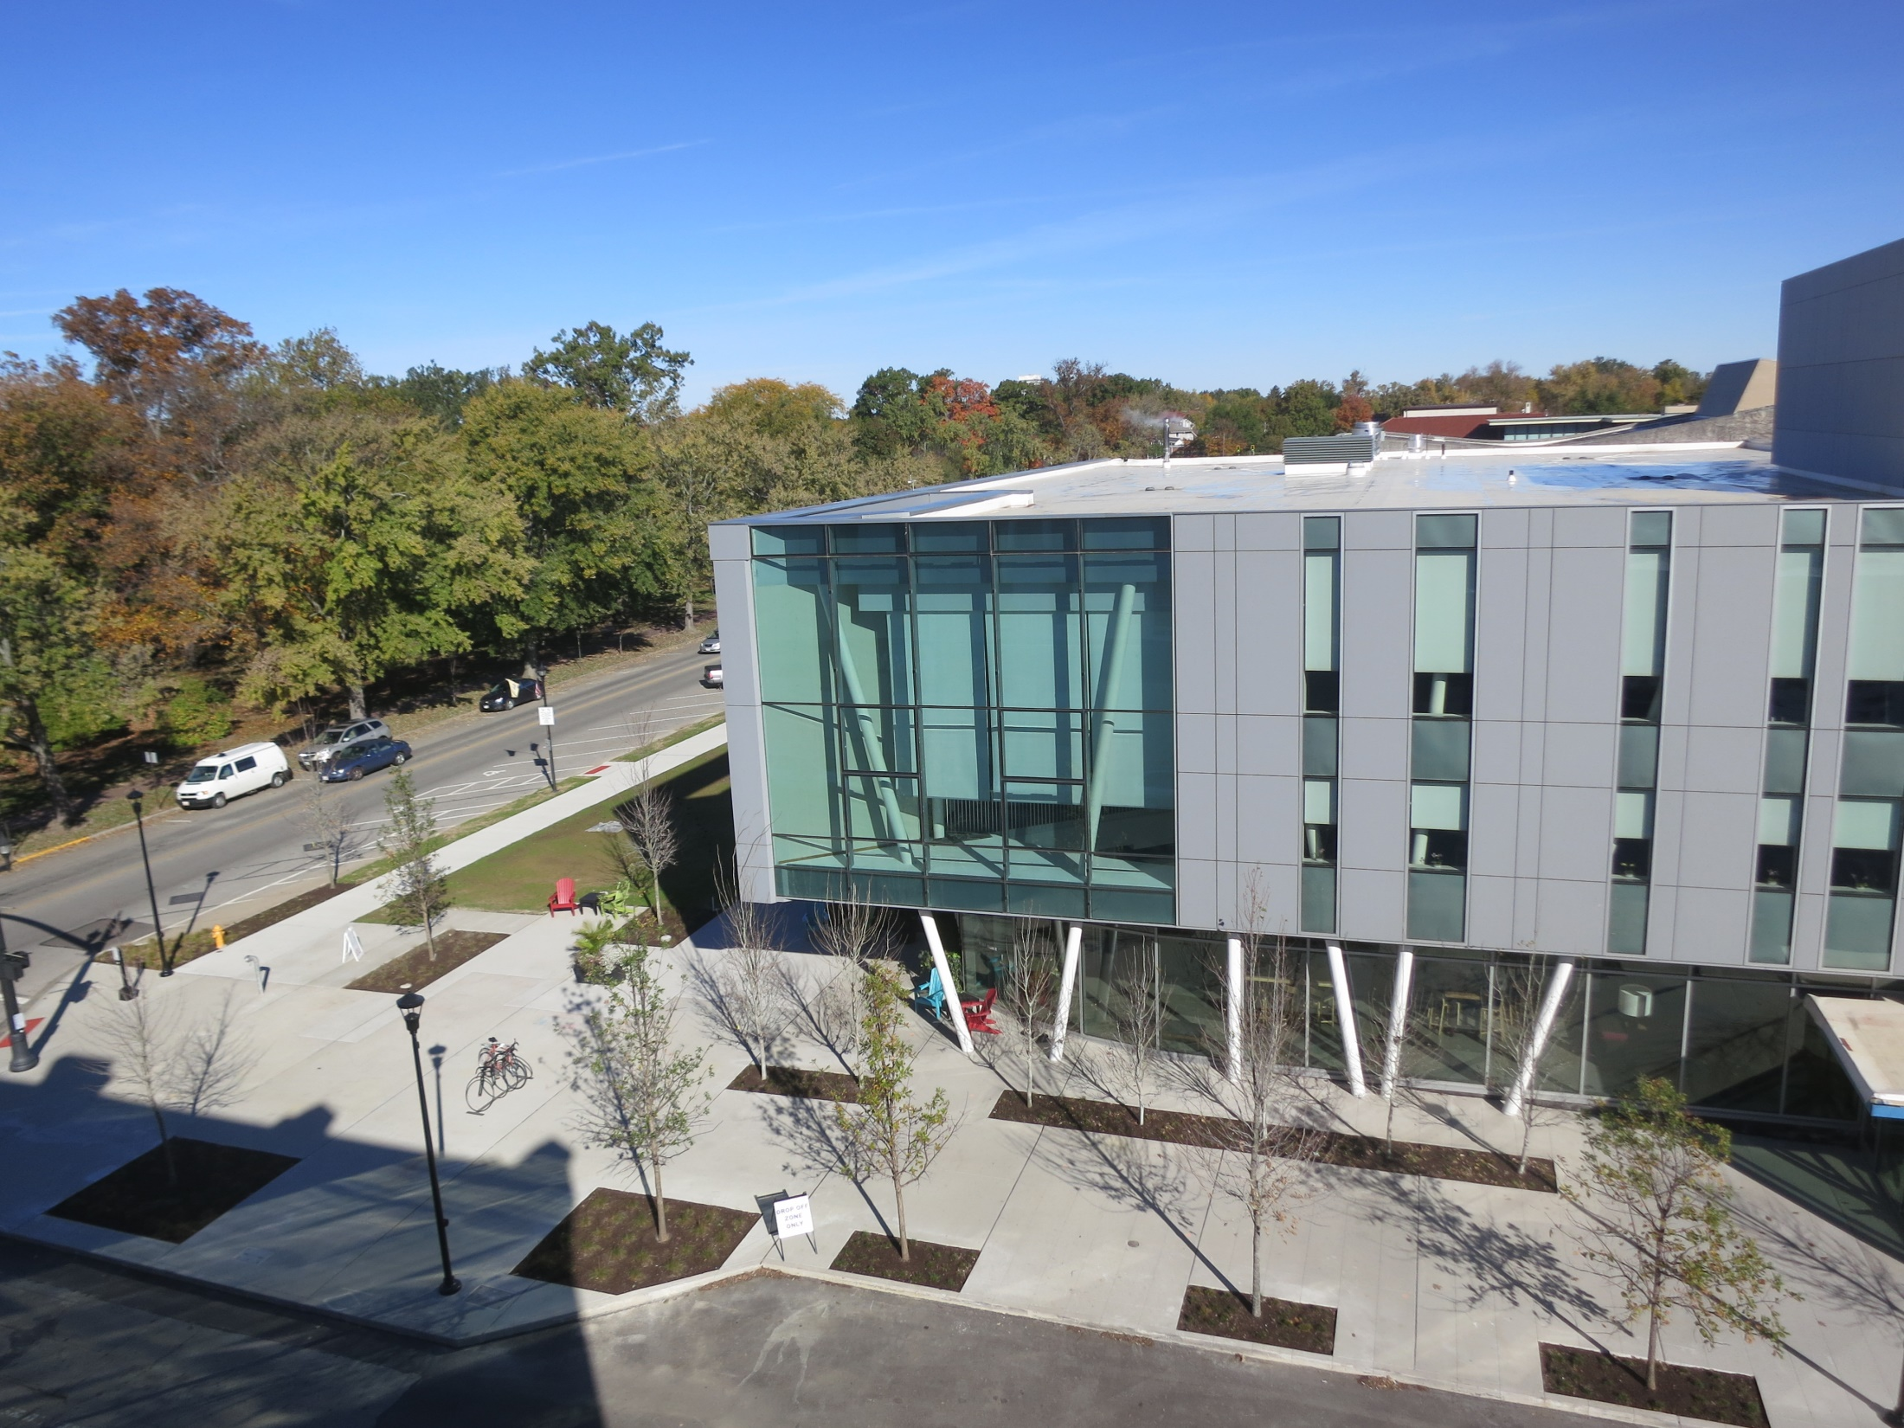
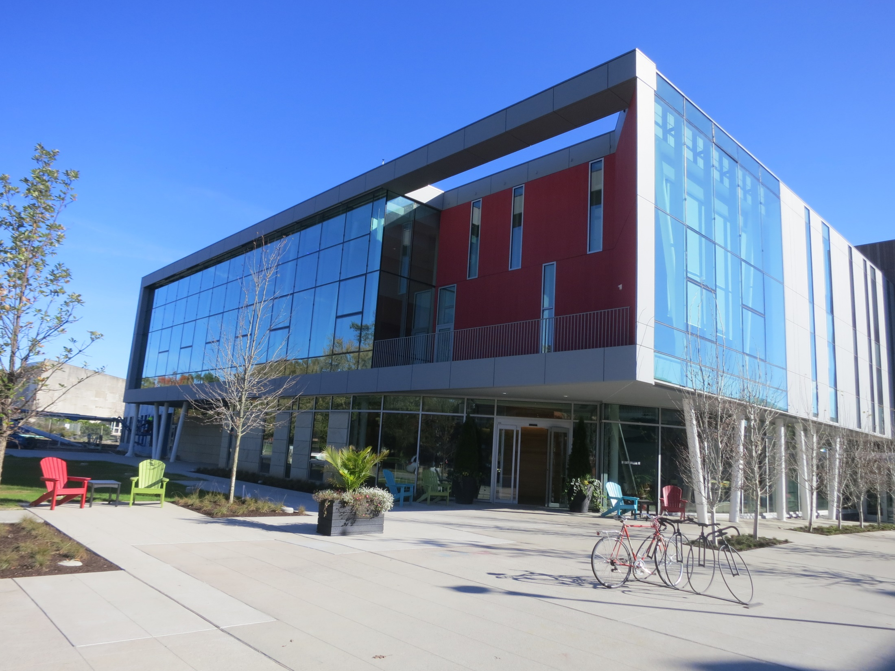

Slide 26
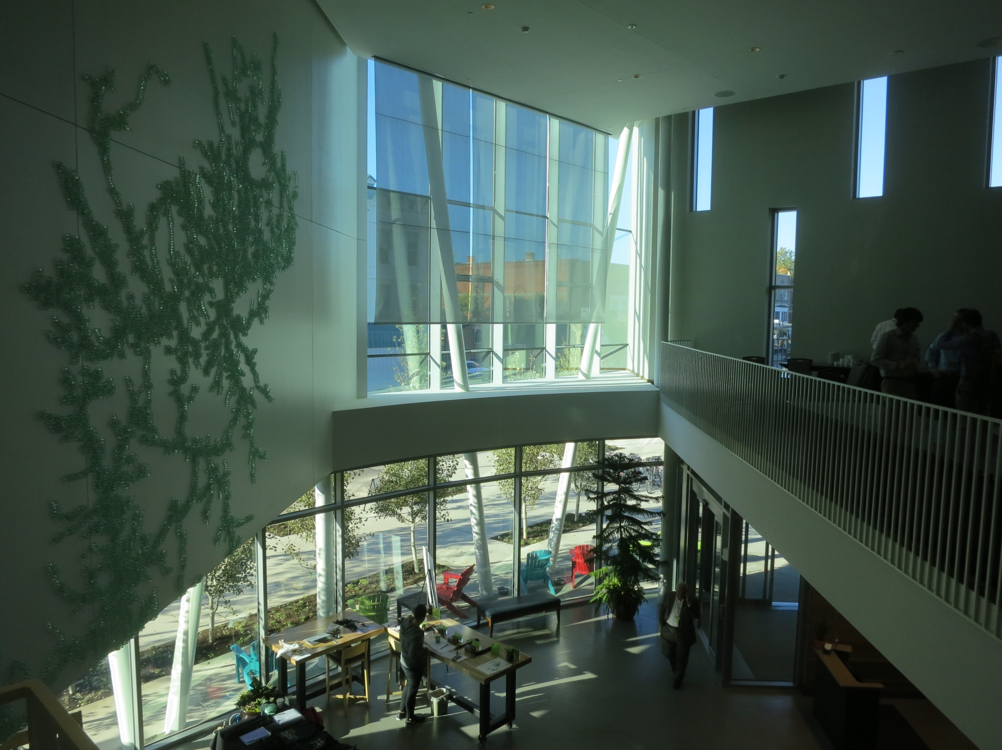

Slide 27
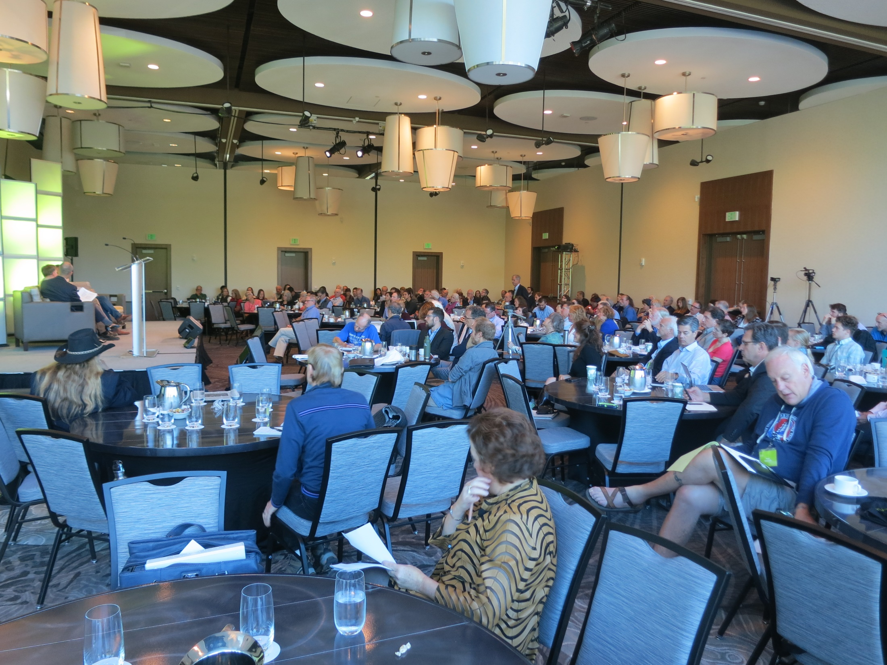

Slide 28
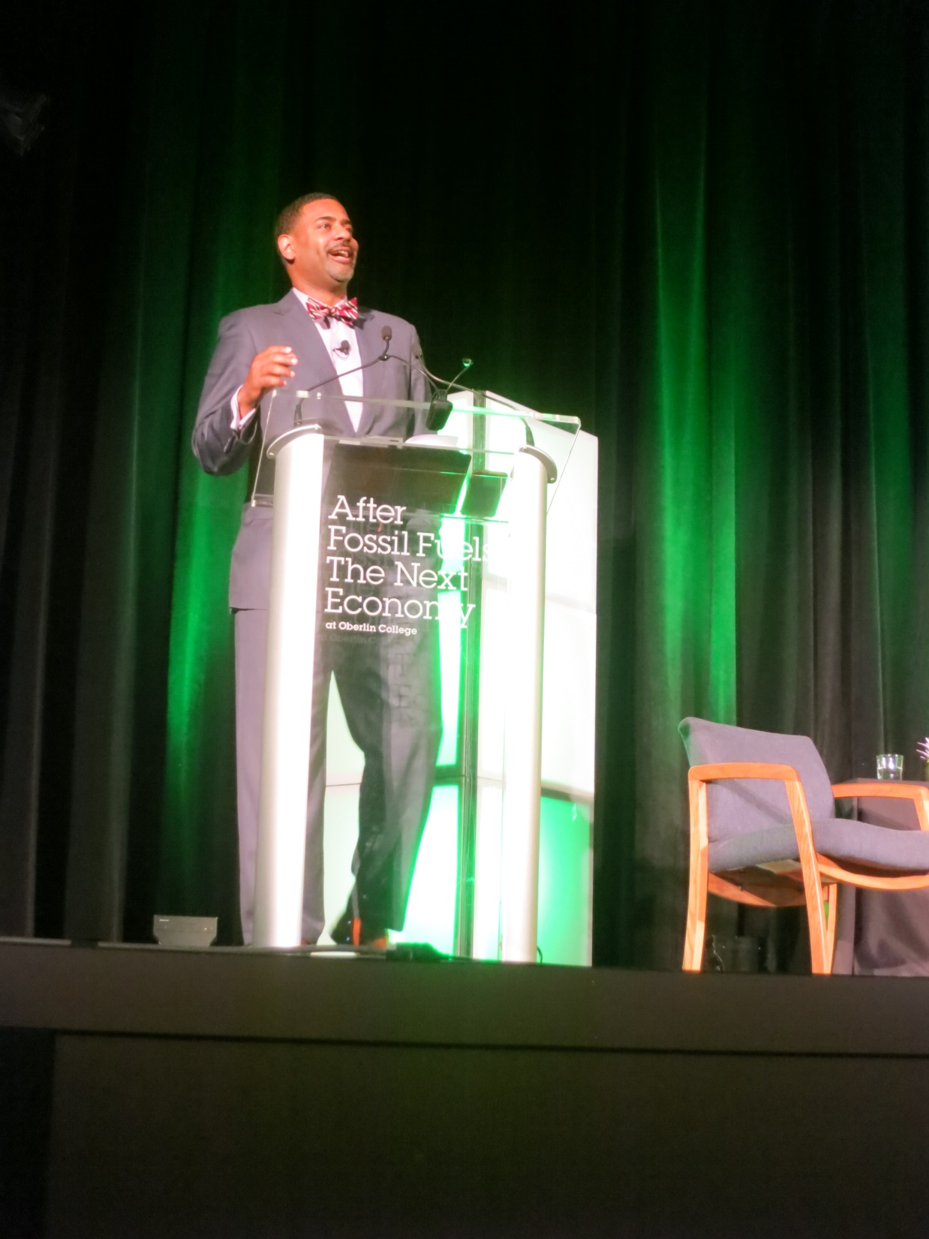

Slide 29
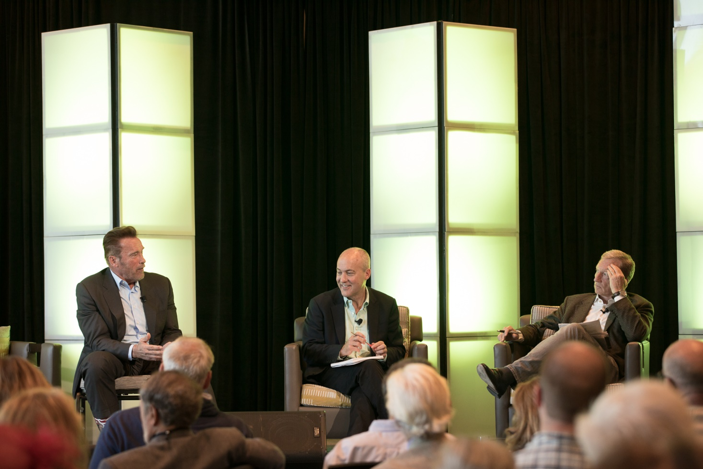

Slide 30
Oberlin Project to date . . .
White House “Climate Champion” city 2014
C-40 . . . “Participant” status
87% carbon free (2013)
3 MW output solar array
$106m spent through 2015
Platinum hotel/conference center 2015
50 affordable, hi-performance houses- 2017
Food hub linking farm and city (2016)
Lake Erie Crescent initiative . . .

Slide 32
import substitution . . . buying/investment to:
universities
colleges
2-year colleges
sports teams
hospitals
airport authorities
public schools
zoos, museums
restaurants
retirement homes
public agencies
urban development
renewable energy
local agriculture

Slide 33
There is such a thing as being too late. Procrastination is the thief of time. Life often leaves us standing bare, naked, and dejected with a lost opportunity. The tide in the affairs of man does not remain at the flood; it ebbs. We may cry out desperately for time to pause in her passage, but time is deaf to every plea and rushes on. Over the bleached bones and jumbled residue of numerous civilizations are written the pathetic words: “Too Late.”
Martin Luther King , 1967

Slide 34
Places to intervene . . . (Donella Meadows)
12) subsidies, codes, standards, taxes
11) sinks, buffers
10) infrastructure, stocks and flows
9) information relative to system change
8) negative feedback loops ie. disincentives
7) positive feed back loops ie. Incentives
6) access to information
5) rules of the system ie. punishments, constraints
4) power of self to evolve
3) goals of system
2) mindset & worldviews
1) transcend paradigms/beliefs
slow damage
Δ structure
Δ consciousness,
but how?

Slide 35
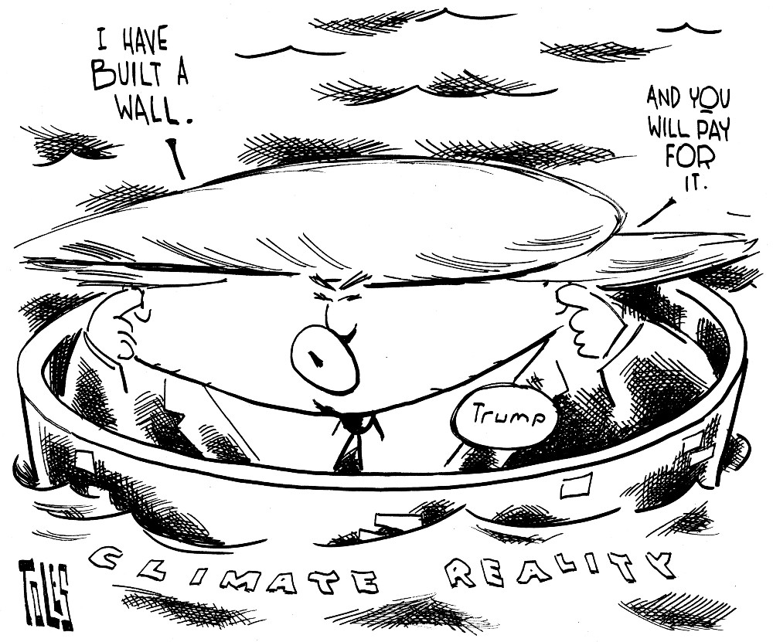

Slide 36
The problem of unsustainability . . .
Systemic errors of societal design will make things worse
and worse . . . until the systemic errors are addressed, the
very conditions for survival and prosperity will continue to
systematically decline . . . The problem is that industrial
society is designed so that pollutants are bound to increase in
concentrations globally . . . .
Karl-Henrik Robert, et.al.

Slide 37
that laws of economics 234 years old can be made to work with those of evolution ~3.8 billion years in the making;
i.e. that infinite growth can continue in a finite system;
that nature’s capital [soils, biological diversity, climate stability, clean air and water etc] has no value;
technology can substitute for ecological scarcity
that more stuff = more happiness

Slide 38
Those of us who have looked to the self-interest
of lending institutions to protect shareholder’s
equity, myself included, are in a state of shocked
disbelief . . . Yes, I have found a flaw. I don’t know how significant or permanent it is. But I have been very distressed by that fact.
Alan Greenspan,
October 23, 2008

Slide 39
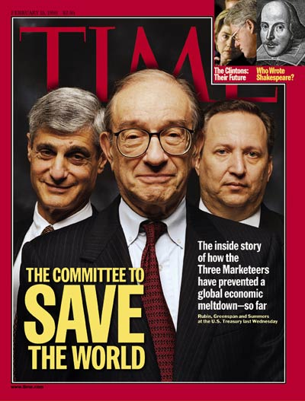
Goldman Sachs
Harvard President
Federal Reserve
(Ayn Rand fan)

Slide 40
we pay for sustainability whether we get it or not.
health
security
environment
social stability
economy
climate
justice

Slide 41
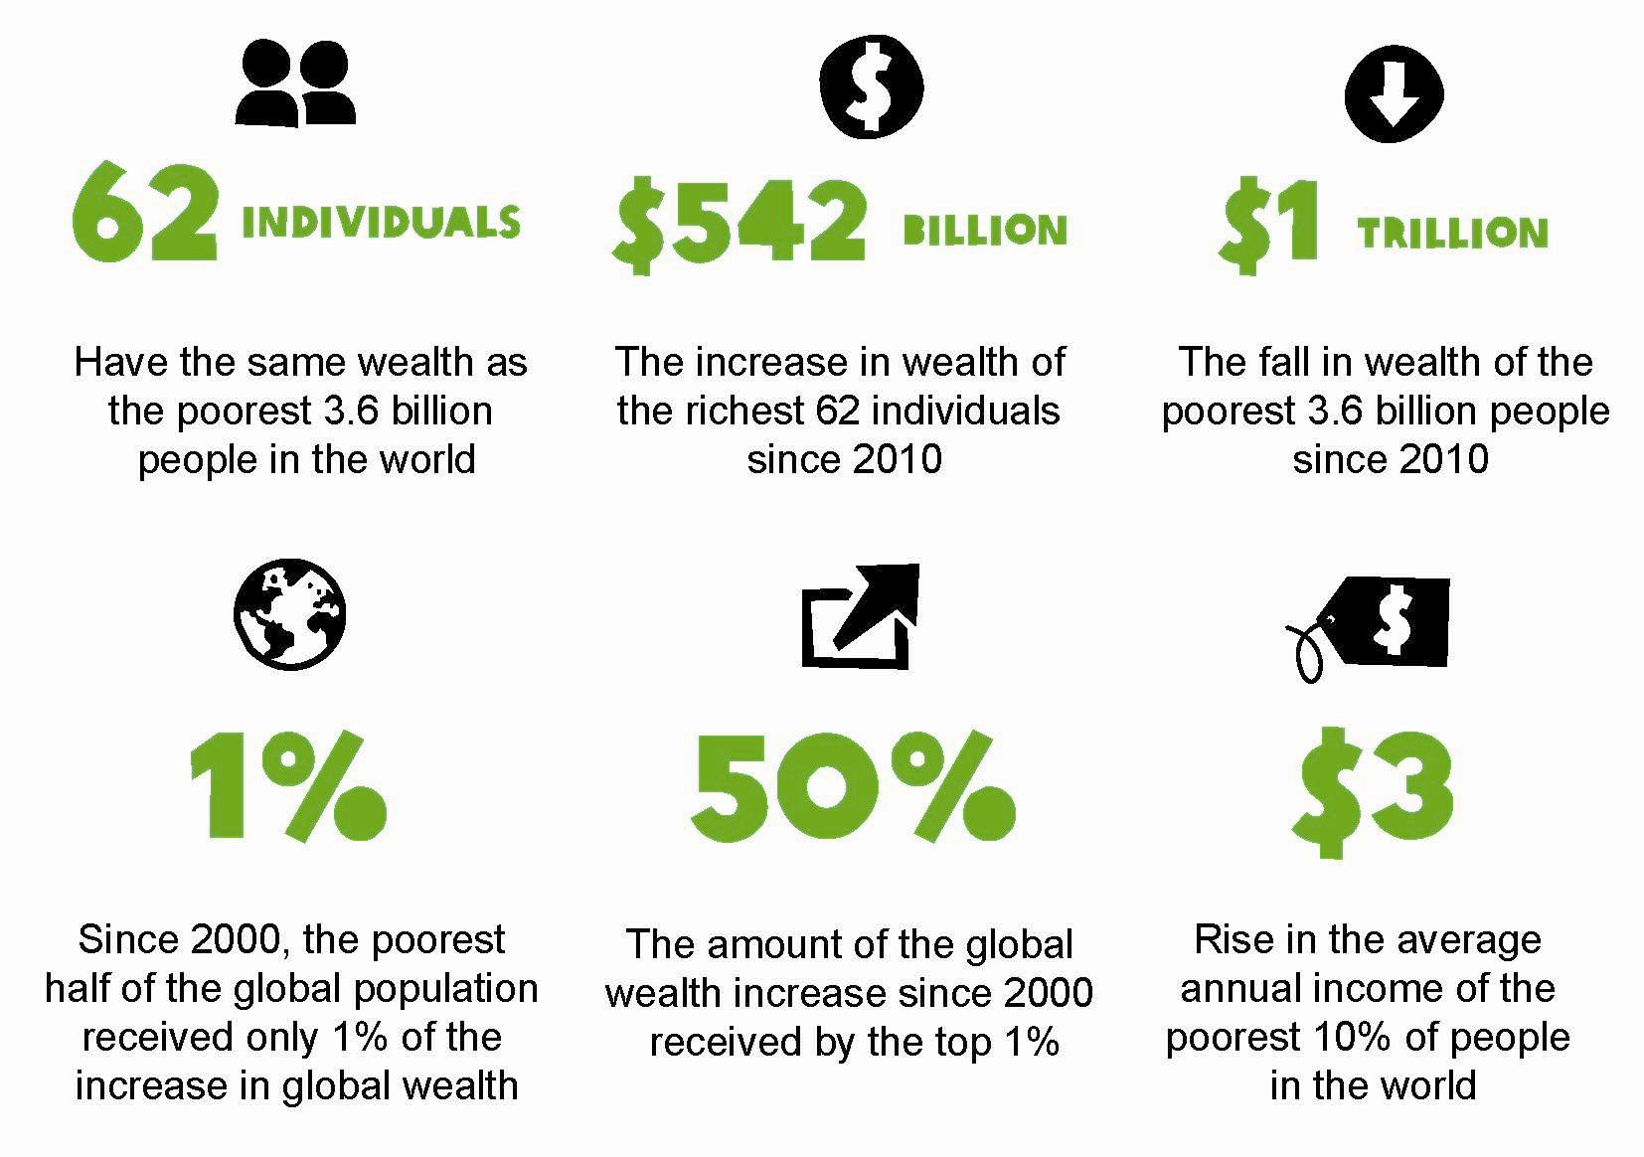

Slide 42
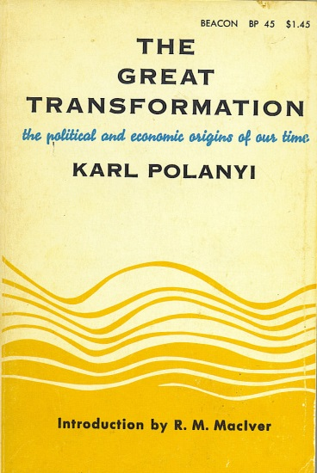
To allow the market mechanism to be sole
director of the fate of human beings and
their natural environment . . . would result
in the demolition of society.
Karl Polanyi
The Great Transformation (1944)

Slide 43
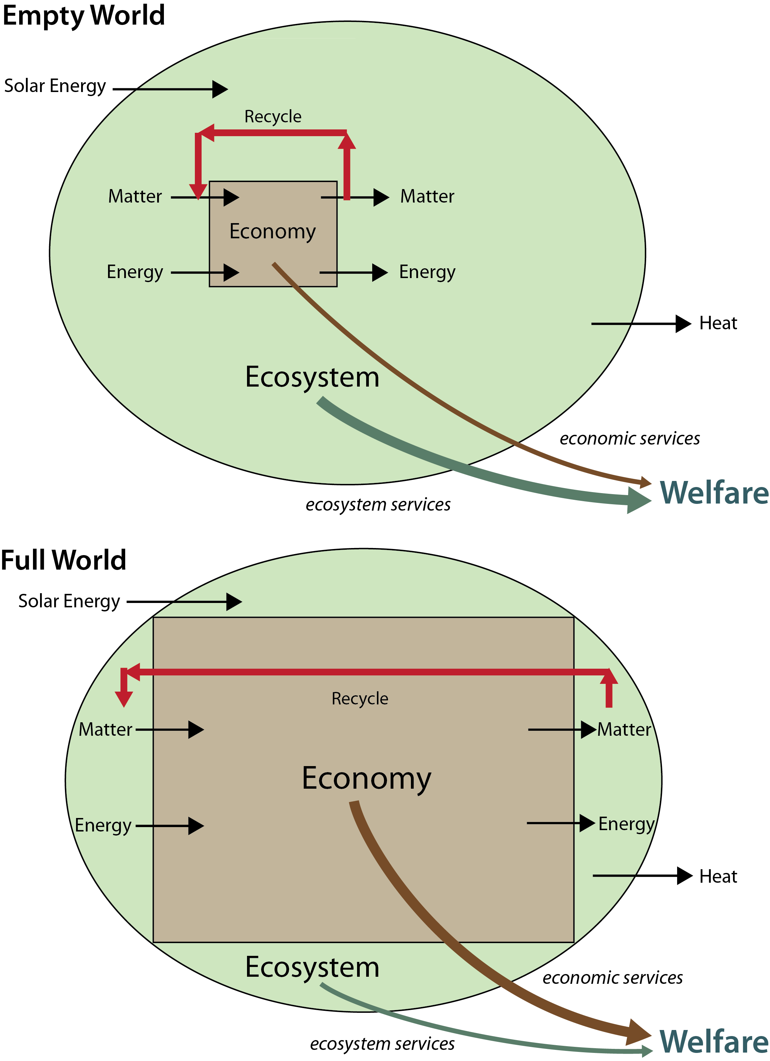

Slide 46
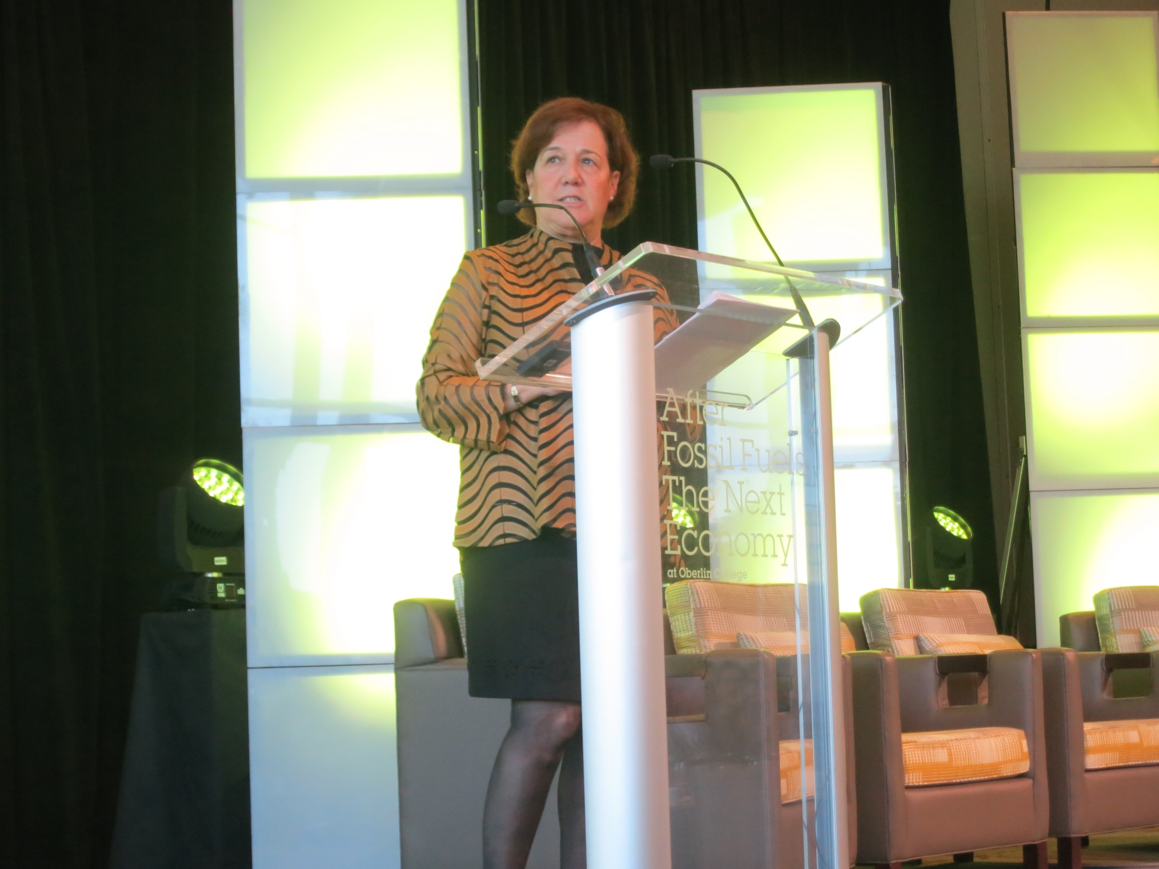

Slide 47
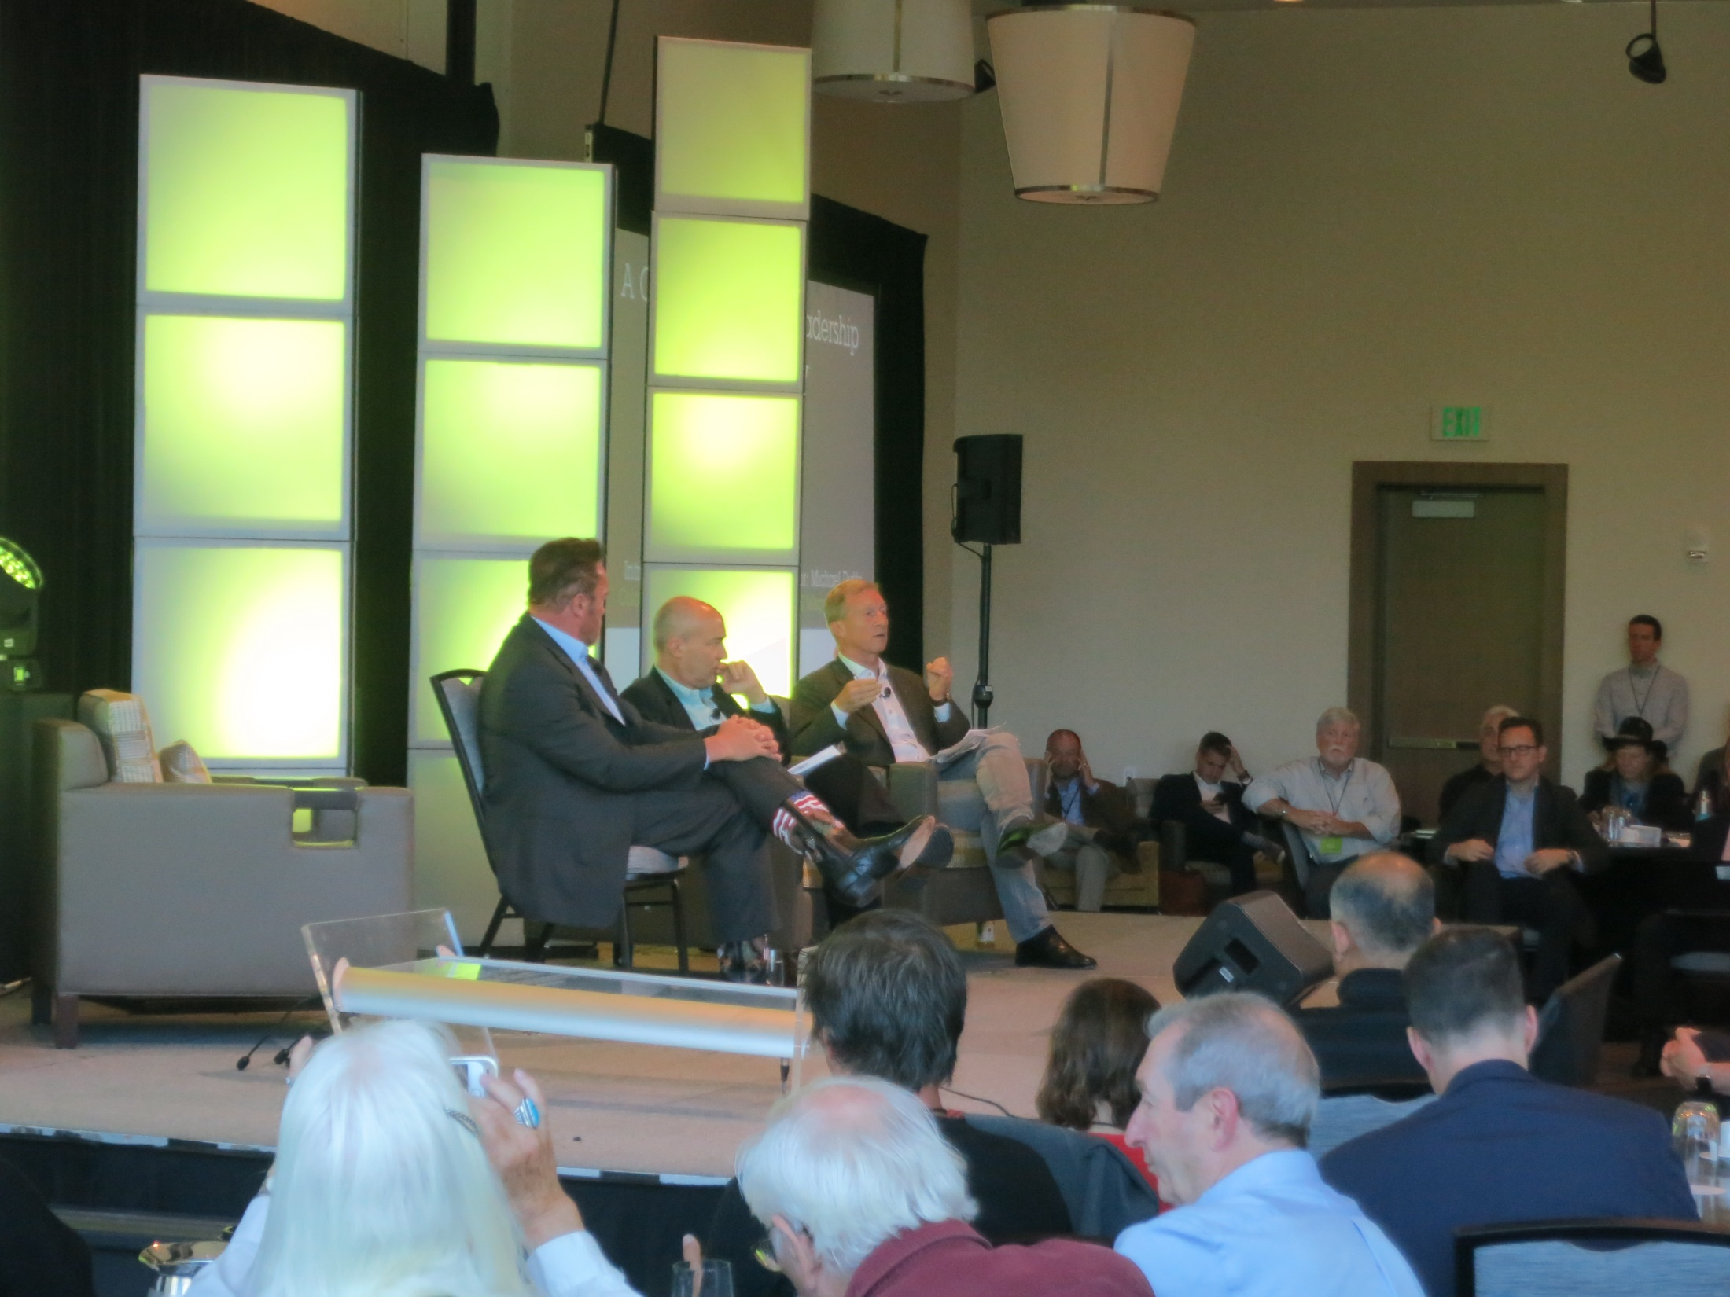

Slide 48
collateral benefits
1. economic renewal
2. multiplier effect of $$ invested locally
3. good work/jobs
4. less pollution
5. improved health
6. less CO₂
7. less crime
8. greater resilience
9. energy efficiency
10. educational innovation . . .
3. synergies i.e. 2 + 2 = 22

Slide 49
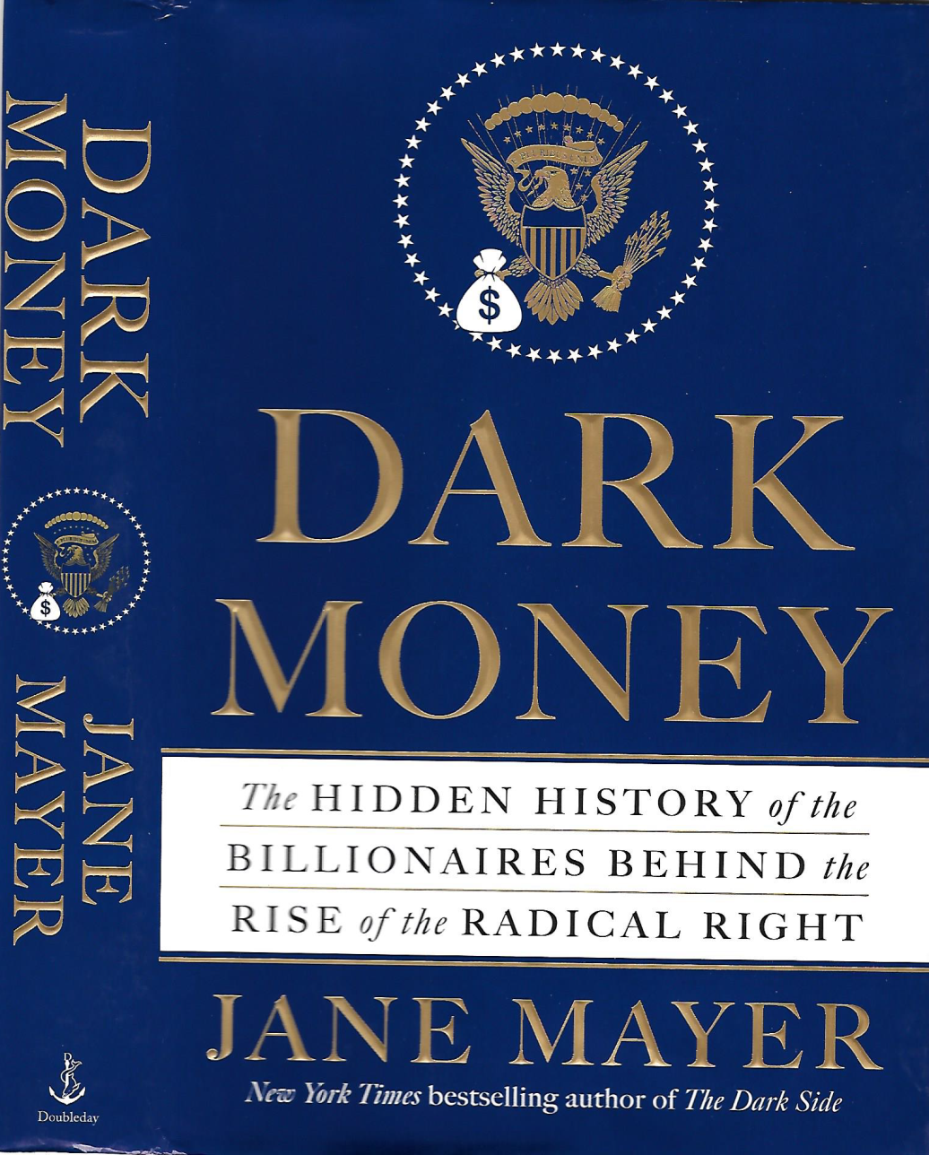
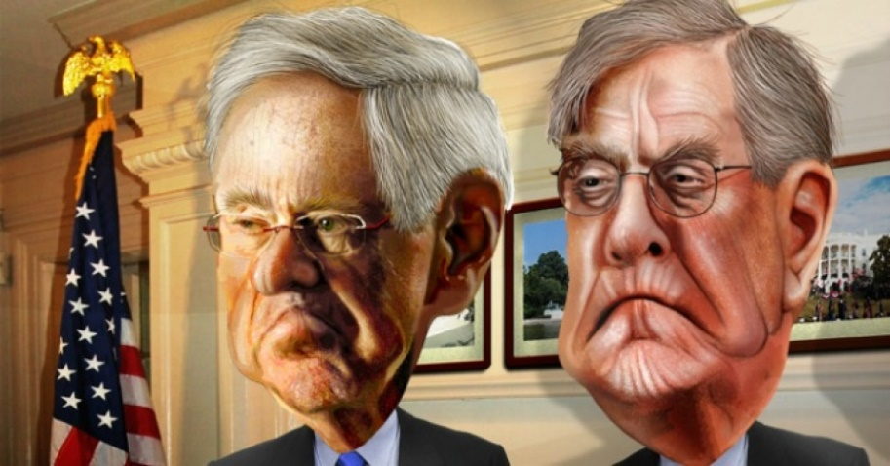

Slide 50
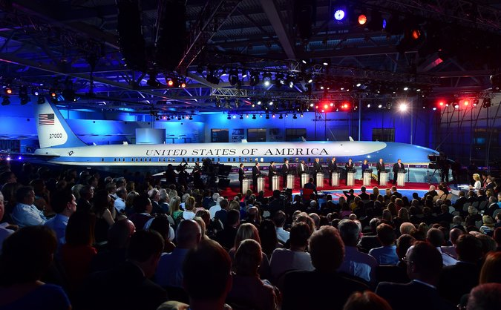

Slide 51
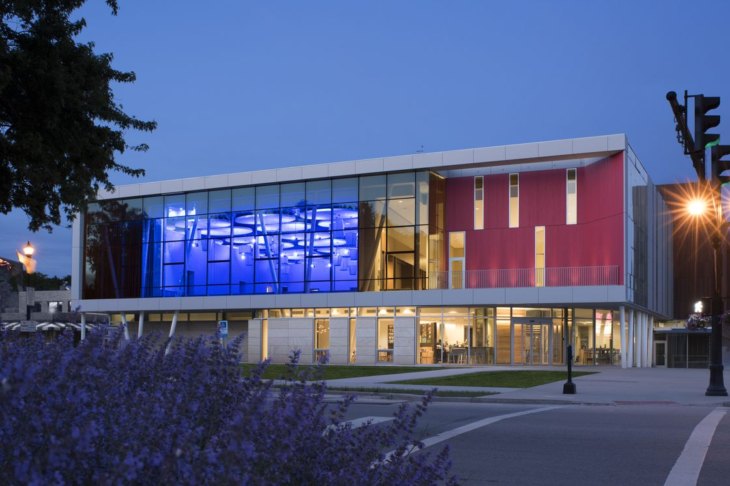

Slide 52
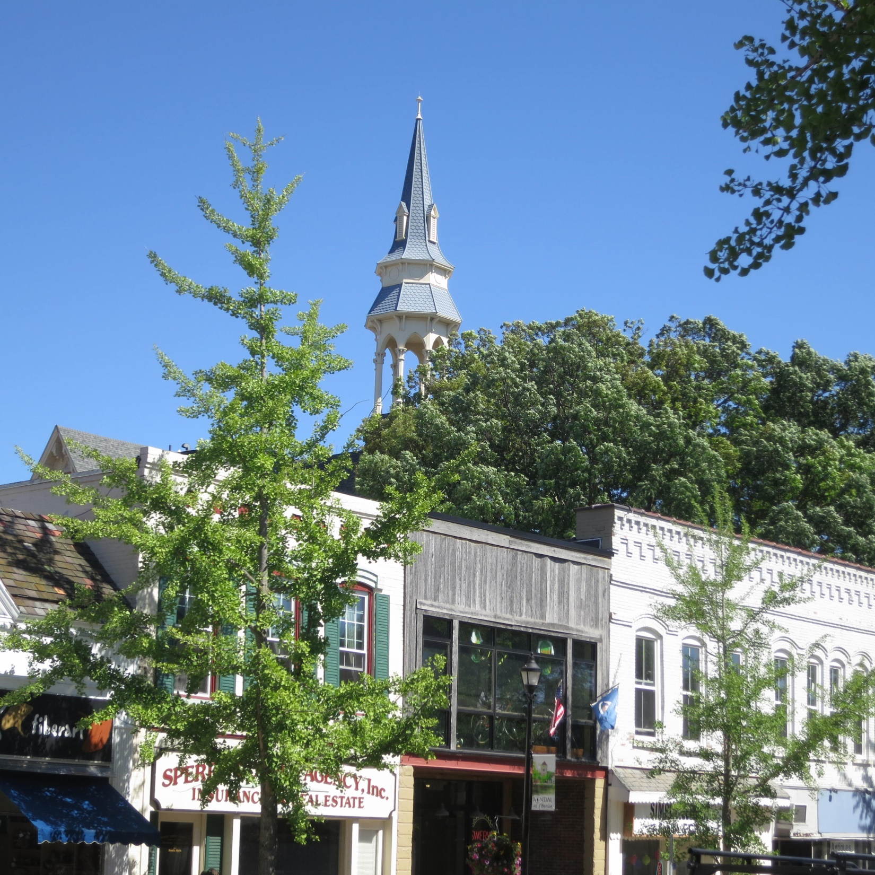

Slide 53
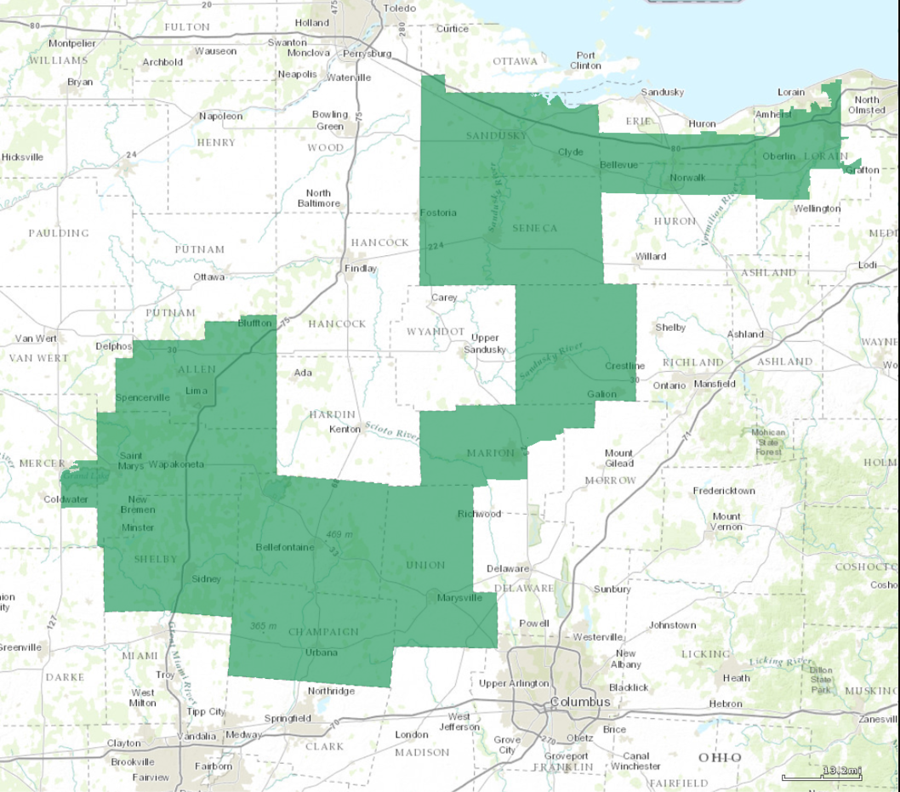
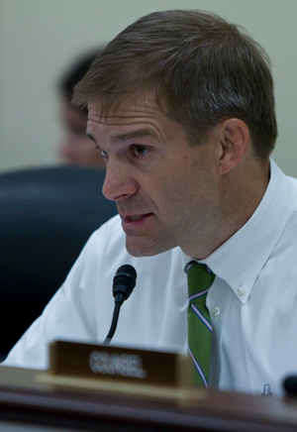
League of Conservation Voters rating: 3 of 100
Lifetime: 5 of 100

Slide 54
Society is a partnership not only between
those who are living, but those who are
living, those who are dead and those who
are to be born.
Edmund Burke, 1790

Slide 55
Liberalism . . .
public Education
child labor laws
eight hour work day
safe food & Water regulations
Social Security
G.I. Bill
civil rights Laws
Medicare/Medicaid
minimum wage
women’s Rights
clean air and water
worker safety
arms control
international Law

Slide 56
Restore integrity of public words
patriotism
conservatism
liberalism
politics
government
public service
rights and responsibilities
taxes . . . the price for civilization

Slide 57
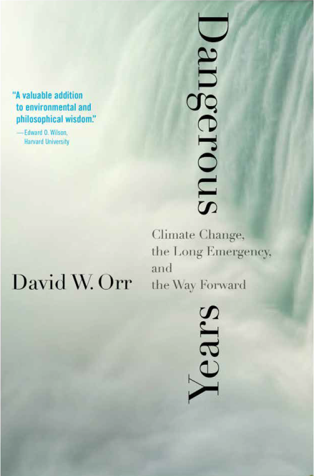
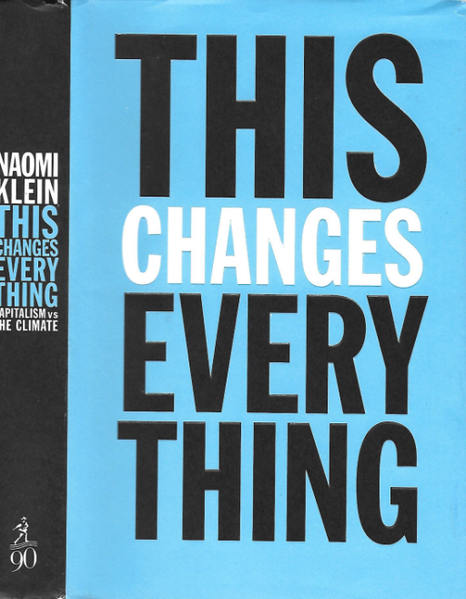
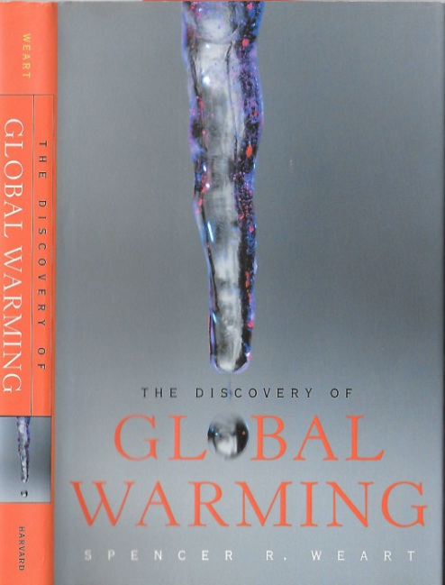
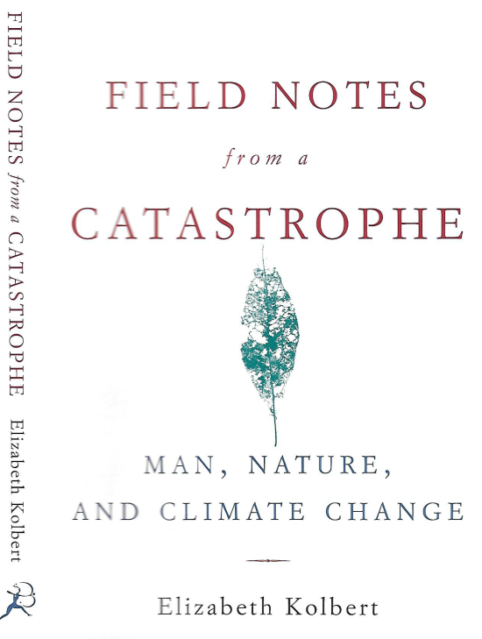
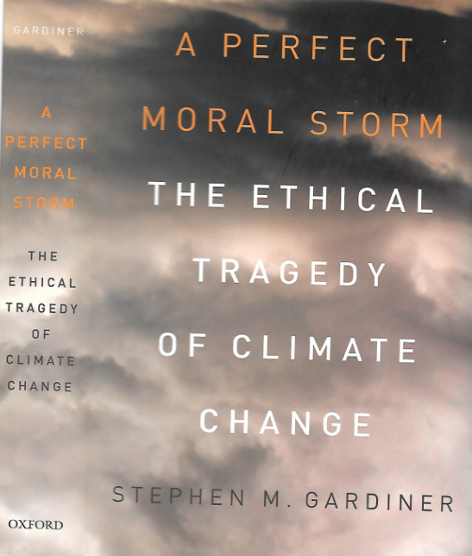

Slide 58
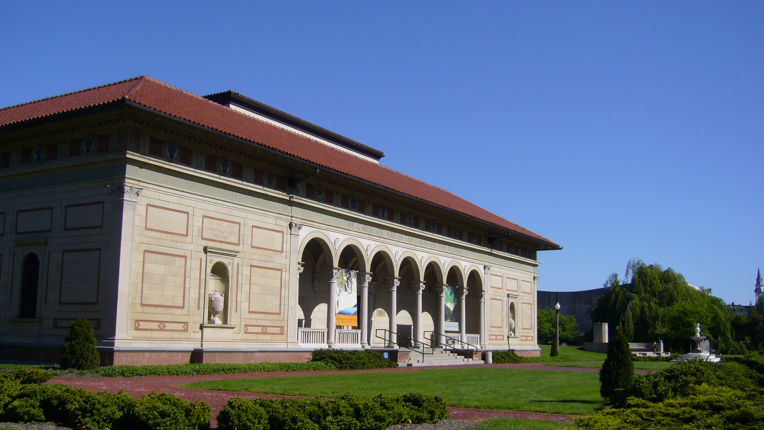
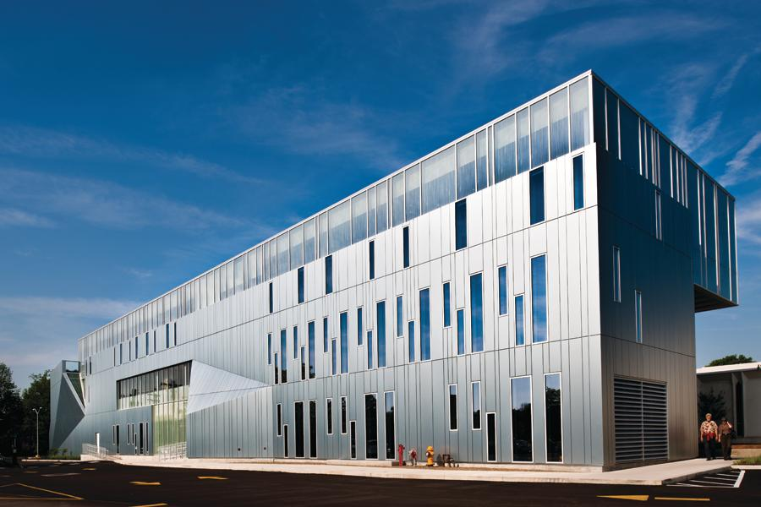
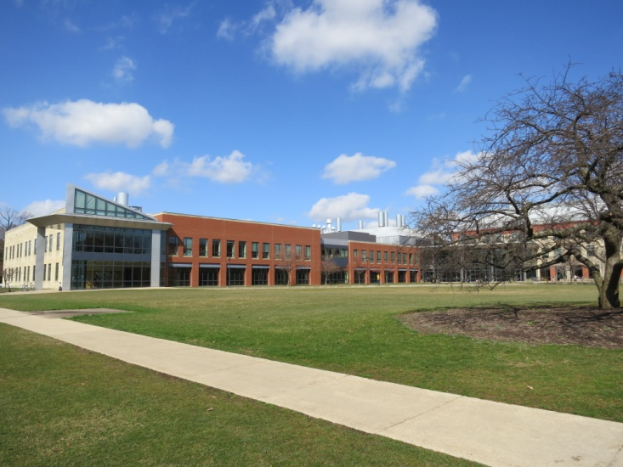
sustainability—a large conversation:
arts + humanities + sciences

Slide 62
full-spectrum sustainability
renewable energy
green building
education
policy and politics
agriculture & forestry
environmental justice
economics & finance

Slide 63
Take home the crisis of sustainability is a:
1. symptom of political and economic failure;
2. systemic, civilizational failure, ie tinkering won’t work.
What to do?
leadership role of anchor institutions;
curricular change
procurement & investment

Slide 64
Dangerous Years:
Climate Change, the Long Emergency, and the Way Forward
David W. Orr
Oberlin Rotary Club
December 2, 2016

Slide 67
Burke, Hsiang, Miguel, Nature, 2015

Slide 69
“40% more often” NOAA

Slide 74
U.K. December 26, 2015

Slide 75
Damage by Pine Bark Beetle . . . 89,000,000 acres

Slide 80
Percent of Children Earning More than their Parents
By Parent Income Percentile
100
1940
80
60
Pct. of Children Earning more than their Parents
40
20
0
0
20
40
60
80
100
Parent Income Percentile (conditional on positive income)
Notes:
Fig 1a

Slide 81
Percent of Children Earning More than their Parents
By Parent Income Percentile
100
1940
80
1950
60
1960
Pct. of Children Earning more than their Parents
40
20
0
0
20
40
60
80
100
Parent Income Percentile (conditional on positive income)
Notes:
Fig 1a

Slide 82
Percent of Children Earning More than their Parents
By Parent Income Percentile
100
1940
80
1950
60
1960
Pct. of Children Earning more than their Parents
40
1970
20
0
0
20
40
60
80
100
Parent Income Percentile (conditional on positive income)
Notes:
Fig 1a

Slide 83
Percent of Children Earning More than their Parents
By Parent Income Percentile
100
1940
80
1950
60
1960
Pct. of Children Earning more than their Parents
40
1970
20
0
0
20
40
60
80
100
Parent Income Percentile (conditional on positive income)
Notes:
Fig 1a

Slide 84
Equality of Opportunity Project, Rej Jetty

